Slide 2
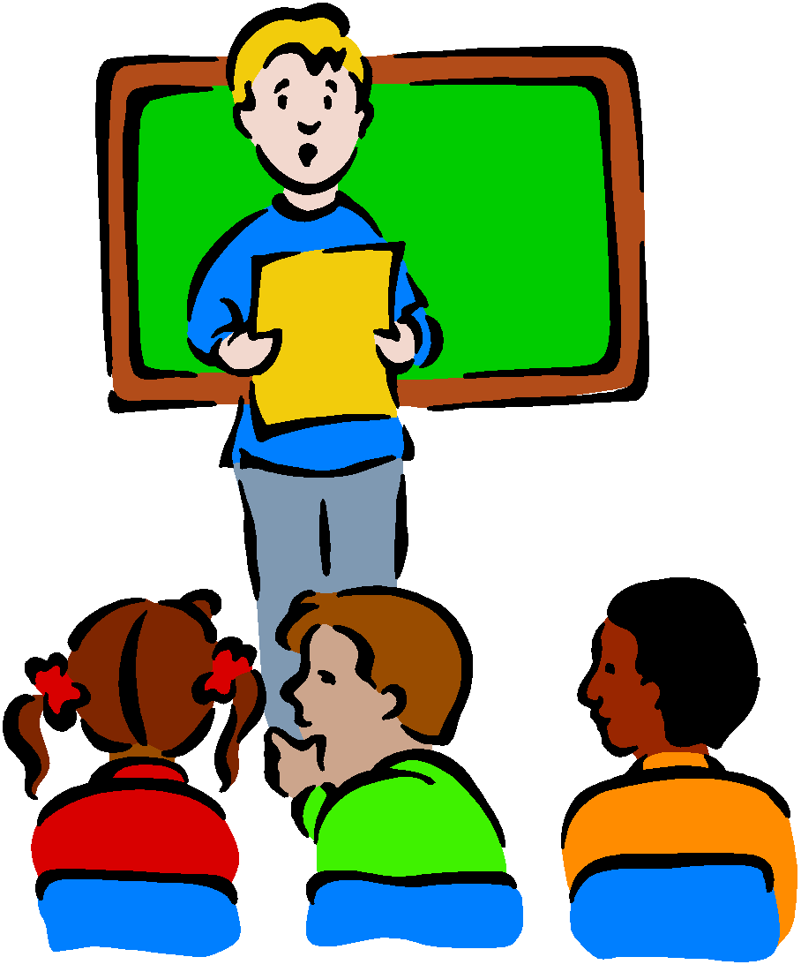
Curriculum Evening Year 4 September 2024
Presented by Miss Job, Mr Coughlin & Mr Neal

Slide 3
Welcome to the
Year 4 Team
Class 8
Miss Job
Class 7
Mr Coughlin & Mr Neal
Teaching Assistants
Mrs Redgrift and Mr Green

Slide 4
Our School Mission Statement:
Love your neighbour as yourself.
Luke 10. Vs 28
Core Values
Faith, Love and Hope.
1 Corinthians 13:13

Slide 5
School Rules:
Be Safe
Be Ready
Be Respectful

Slide 6
Year 4 Curriculum.
English and Maths
Writing Cycle:
Mon - GPAS
Tues - Active Reading
Wed - Planning
Thurs - Writing
Fri - Editing
Maths:
Mastery Maths - Maths No Problem - Textbook & Workbook
Fluency - daily times tables and maths problems (NCETM) - MTC (June)

Slide 7
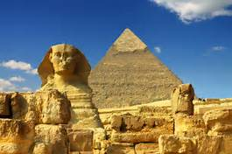
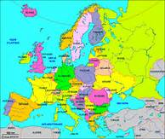
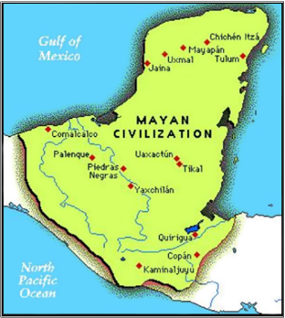
Year 4 Curriculum.
Autumn Term – Our World
Ancient Egypt
The United Kingdom: Land Use
Christmas Service
Spring Term – Our Community
STEAM
Refugees
Swimming
Summer Term – Our Environment
The Maya
Local Area
Residential TBC

Slide 8
RSE
At the end of the year, the boys and girls will separately learn about how their bodies change.
These are things we cover:
Hygiene, emotions, body hair, periods(girls) and changes of the body.
The videos that stimulate our conversations are sent out prior to this lesson.

Slide 9
Homework
Online tasks will be set every FRIDAY to be completed by the following FRIDAY (before school).
Mathletics
Spelling Frame
TT Rockstars
Spag.com

Slide 10
Homework
Reading books
We encourage children to read a variety of literature, both their school book and others of their own choosing. Any reading can be recorded in their Reading Logs. Books must be signed off for it to be changed. It will be changed on the following days:
Monday – Ashton
Tuesday – Beacon
Wednesday – Hilbre
Thursday – Marine
Friday - Shore

Slide 11
How can you help at home?
Read for 10 minutes everyday, this does not always have to be their school reading books. Ask questions to check understanding and inference.
In Year 4, children will learn 6x, 7x, 9x, 11x and 12x tables and when ready, division facts for these tables. When all tables are learnt, soundcheck on TT Rockstars is very useful. ANY and ALL times table practise is useful.
In June there will be a Statutory Times Tables Test that all children have to complete online.
Practise telling the time.

Slide 12
How can you help at home?
Practise the Year ¾ Common Exception words.

Slide 13
E-safety
Keep your personal stuff private and think about what you say and do online.
Remember that people online may not be who they say they are. Online friends are still strangers even if you have been talking to them for a long time.

Slide 14
Archbishop of York Young Leader Award 2024/25
The KS2 Award is a fully resourced leadership, character education and personal development programme, where pupils develop core skills and have practical opportunities to volunteer and help others in their community.
For our schools, the Award has strong links to SMSC, British Values, PSHE, Character Education, Citizenship, RE and SIAMS.

Slide 15
Thank you for your attendance, this evening’s slides will be available online.

