Slide 1

Welcome to Year 2

Slide 2
Year 2 Curriculum Evening
Teachers
Class 4 - Miss Boylan
Class 3 - Mrs Lacey (Monday, Tuesday and Wednesday)
Mrs Taziker - (Wed, Thursday and Friday)
Teaching assistants
Miss Thomas and Mr Cox

Slide 3
Our Expectations
Mission Statement
Love your neighbour as yourself
Luke 10:27
School Rules
Be safe, Be Ready and Be Respectful

Slide 4
Curriculum
Each term’s topic/curriculum focus are outlined on our website.
Our World- The Moon, Great Fire of London
Our Community- Social Justice and STEAM
Our Environment- Our Local Area
Some books that are linked to our Topics
Sea of Tranquillity (Mark Haddon)
The Twits (Roald Dahl)
Peter Rabbit (Beatrix Potter)

Slide 5
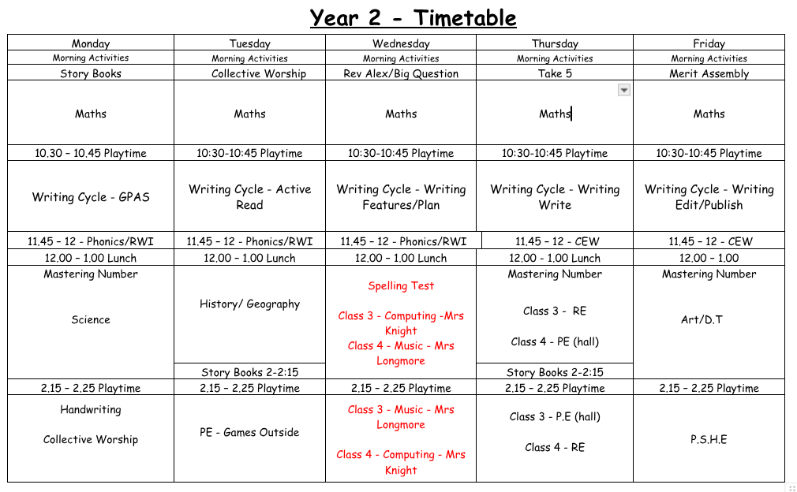

Slide 6
Timetable/Homework
PE- Tuesday and Thursday, children to come to school in PE kit on these days.
Reading books will go home on your allotted day, in line with your child’s team (1 book each week plus their Story book).
Spelling frame website will have new spellings each Thursday, please make sure you are logging on regularly with your child. Your child will be tested on these every Wednesday
Maths- Set on Thursdays linked to the curriculum. We are not using Mathletics anymore.
Important pick up changes/information please email school office to follow our safeguarding protocol.
Other information that is not urgent please use year2comms@stbridgets.wirral.sch.uk

Slide 7
E-safety
Supervision and boundaries - use devices in a shared open space and set clear rules about when and how a child can be online.
Know what they are using - Take an interest in their apps, games and websites. Be mindful of age ratings and parental controls.
Talk openly and regularly - Remind children they can always come to you. Open communication is the best safeguard.
Model positive use - 80% of child’s learning is imitation. Being mindful of our behaviours is a great way to instil positive online conduct in our children.

Slide 8
Literacy Curriculum
Monday- GPAS (Grammar, punctuation, and spelling)
Tuesday- Active read session (reading comprehension)
Wednesday- Friday - Writing cycle (Explore, plan, write and edit)
Other Aspects
2 x Common Exception Words
3 x weekly phonics sessions, will transition into Year 2 spelling rules.
Discreet handwriting lessons, building cursive handwriting.

Slide 9
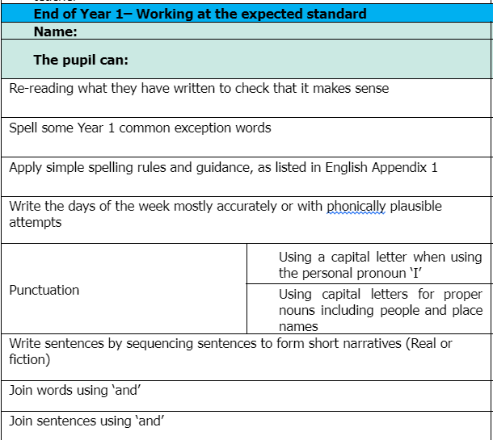
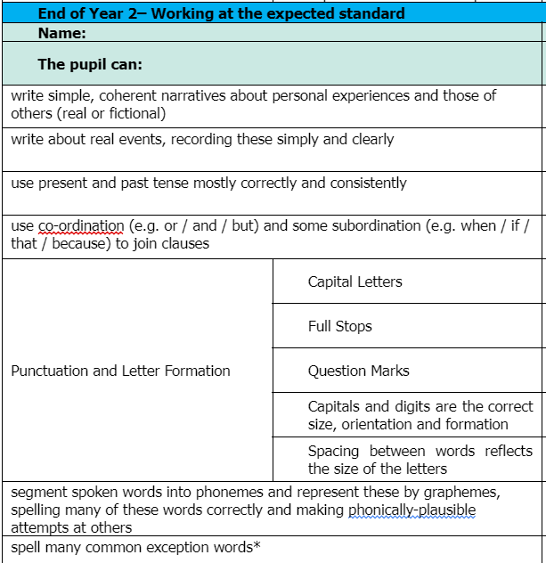
Literacy Curriculum

Slide 10
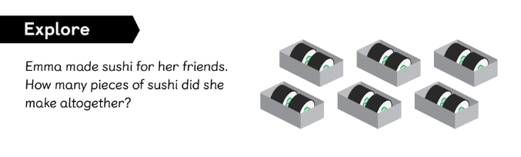
Maths
We adopt a mastery approach,which is a deep long term understanding rather than just memorising.

Slide 11
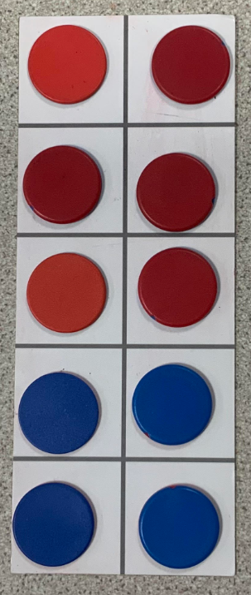
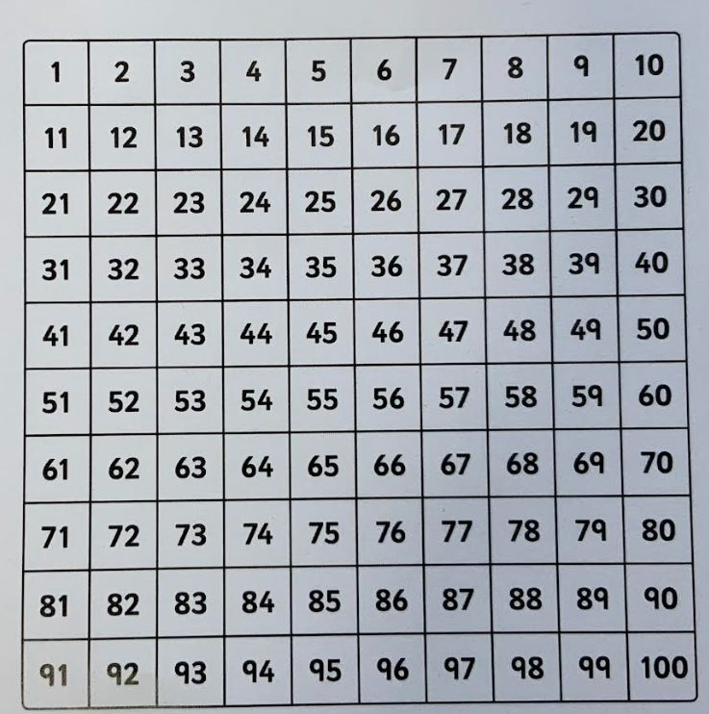
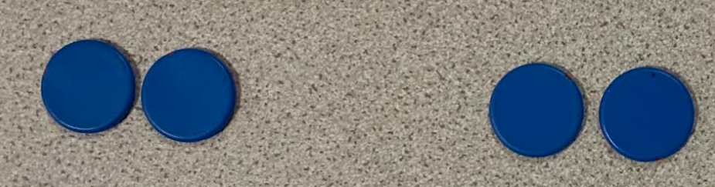
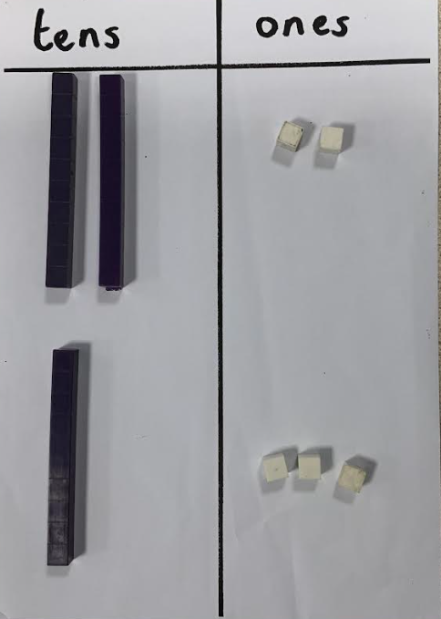
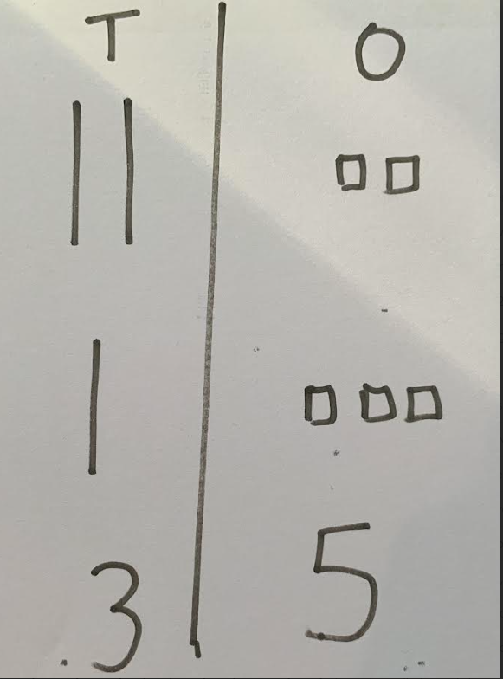
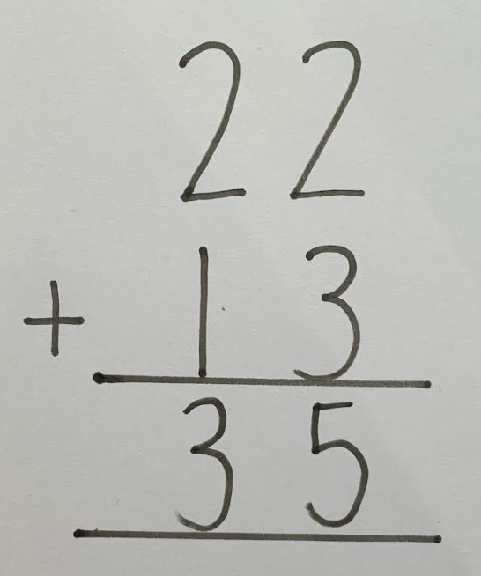
Maths
concrete pictorial abstract

Slide 12
Calculation Examples

Slide 13
Maths Summary
4 main operations, addition, subtraction division, multiplication which are used throughout each topic covered.
Use of practical apparatus
At home practise doubles, half of numbers to 20,number bonds to 20, recognising numbers to 100, counting in 2s,5s,10s.
Column Method
After half term begin to learn multiplication (tables) 2s 5s 10s
Telling the time

Slide 14
SATS
As of 2023, SATS were no longer a legal requirement.
We will use them informally at the end of the year to help with our teacher assessment.
We will not report the SATS scores to you, as they are reflected within our end of year judgements.

Slide 15

Thank you

