Slide 1
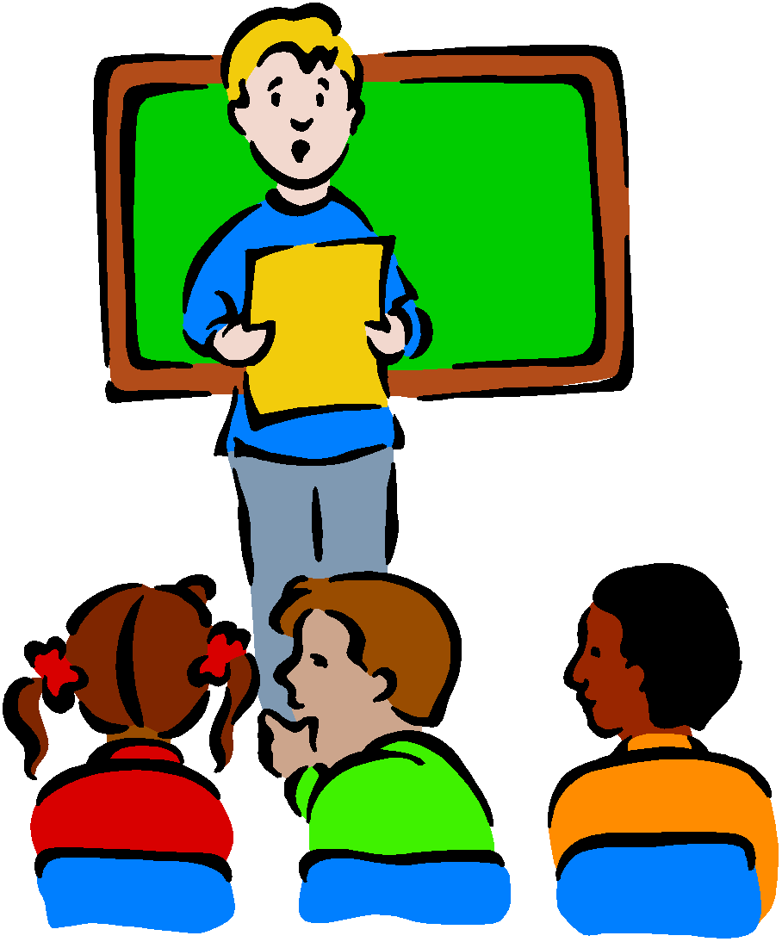
Curriculum Evening Year 4 October 2023
Presented by Mr Owen and Miss Job

Slide 2
Welcome to the
Year 4 Team
Class 8
Miss Job
Class 7
Mr Owen
Amazing Teaching Assistants
Mrs King and Miss Grisdale

Slide 3
Our School Mission Statement:
Love your neighbour as yourself.
Luke 10. Vs 28
Core Values
Faith, Love and Hope.
1 Corinthians 13:13

Slide 4
School Rules:
Be Safe
Be Ready
Be Respectful

Slide 5
Our School Vision Statement:
Inspiring, nurturing and educating our children to serve God, by reaching their full potential, serving our local community and by looking after our environment as global citizens of today and tomorrow.

Slide 6
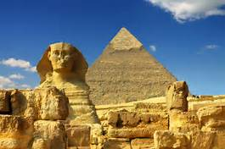
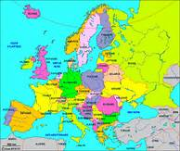
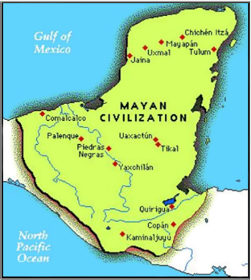
Year 4 Curriculum.
Autumn Term – Our World
Ancient Egypt
The United Kingdom: Land Use
Christmas Service
Spring Term – Our Community
STEAM
Refugees
Swimming
Summer Term – Our Environment
The Maya
Local Area
John Muir Award

Slide 7
RSE
At the end of the year, the boys and girls will separately learn about how their bodies change.
These are things we cover:
Hygiene, emotions, body hair, periods(girls) and changes of the body.
The videos that stimulate our conversations are sent out prior to this lesson.

Slide 8
Homework
Online tasks will be set every FRIDAY to be completed by the following FRIDAY (before school).
Mathletics
Spelling Frame
TT Rockstars
Spag.com

Slide 9
Homework
Reading books
We encourage children to read a variety of literature, both their school book and others of their own choosing. Any reading can be recorded in their Reading Logs. Books must be signed off for it to be changed. It will be changed on the following days:
Monday – Ashton
Tuesday – Beacon
Wednesday – Hilbre
Thursday – Marine
Friday - Shore

Slide 10
How can you help at home?
Read for 10 minutes everyday, this does not always have to be their school reading books. Ask questions to check understanding and inference.
Begin to add and subtract two 4 digit numbers using a formal method, moving onto mentally adding two 4 digit numbers.
Learn 6x, 7x, 9x, 11x and 12x tables and when ready division facts for these tables. When all tables are learnt, soundcheck on TT Rockstars is very useful.
In June there will be a Statutory Times Tables Test that all children have to complete online.
Practise telling the time.

Slide 11
How can you help at home?
Practise the Year ¾ Common Exception words.

Slide 12
E-safety
Keep your personal stuff private and think about what you say and do online.
Remember that people online may not be who they say they are. Online friends are still strangers even if you have been talking to them for a long time.

Slide 13
Any questions?

