Slide 1
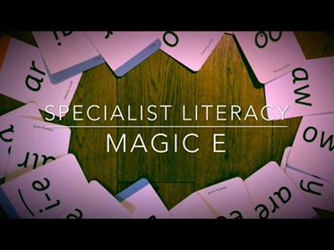

Slide 2
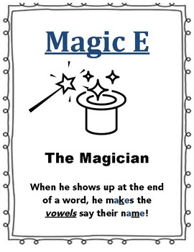
What is the magic e ?
When you have a magic e at the end of a word it makes the vowel say its name.
You may find it useful to read the short and long vowel sounds in the vowels powerpoint before you start.
The proper name for magic e is a split digraph, this just means two letters that make one sound split between a consonant.

Slide 3

What does this mean?
Read this word first pet
the vowel makes the short sound of ‘e’.
Now read the same word but with the ‘magic e’ Pete.
The ‘magic e’ makes the first ‘e’ say its long name.

Slide 4
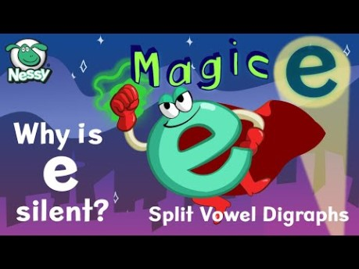

Sit back and Watch these videos

Slide 5

Try reading these with and without the magic e – use the audio to help

Slide 6
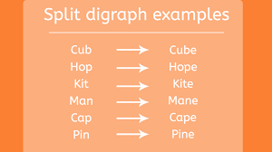
Try reading these on your own

Slide 7
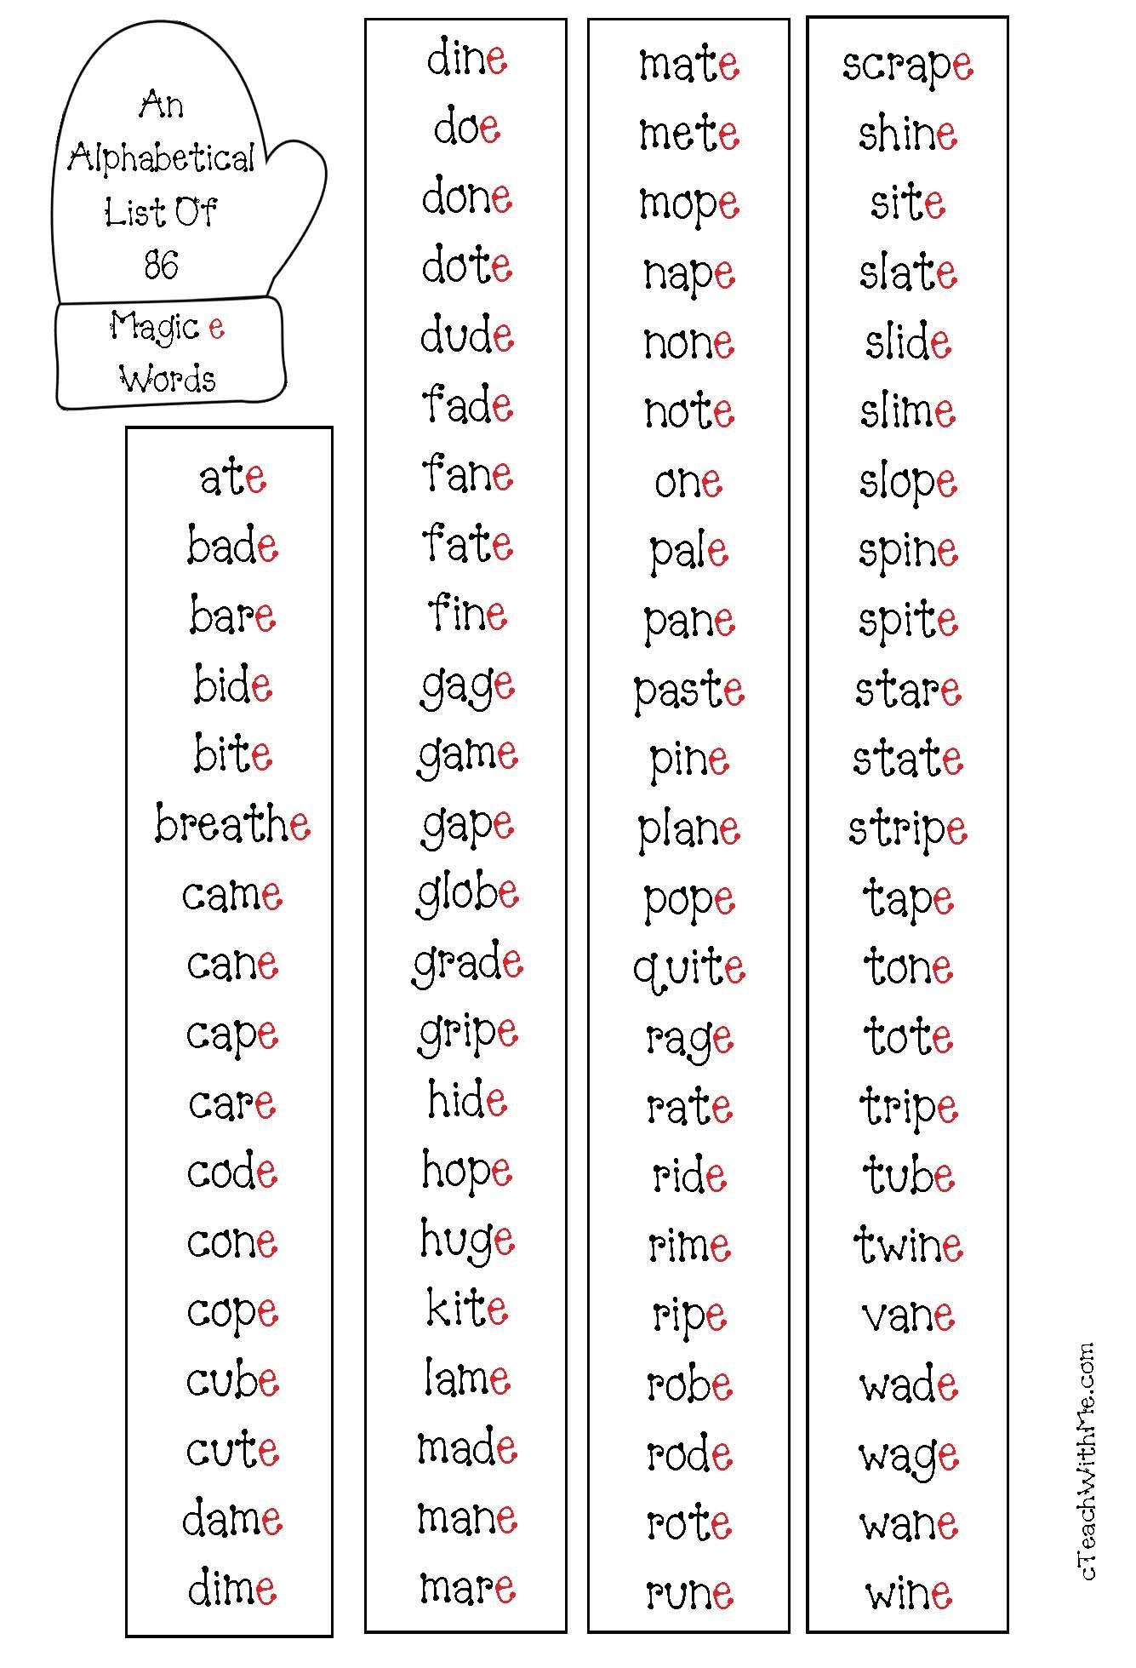
More practise

