Slide 1
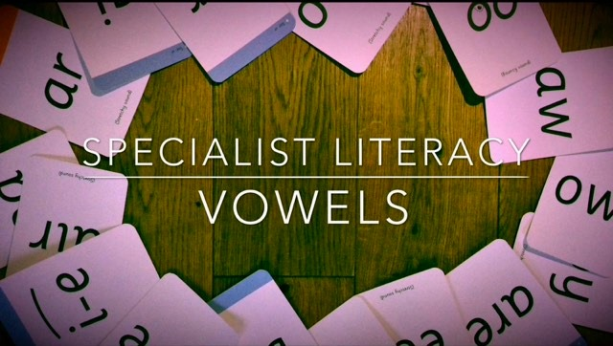

Slide 2

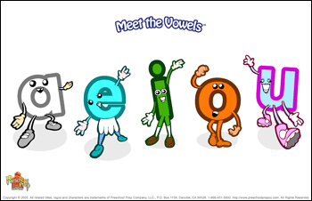
What are vowels?
All words will contain at least one vowel and within each word, every syllable will have a vowel. There are 5 vowels.

Slide 3
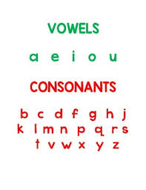
What is a consonant?
Any letter that isn’t a vowel is called a consonant.
The letter y is a bit different, sometimes it acts as a consonant, sometimes a vowel. We’ll look at this more in a separate powerpoint.

Slide 4
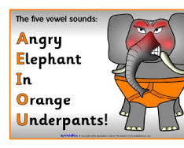
Using a mnemonic
A mnemonic (a sentence, image, acronym, song, phrase or rhyme to help us remember facts and spellings) can help us remember what the vowels are, for example we can draw this elephant.
A E I O U
a e i o u

Slide 5
What is the Long vowel sound ?
The long vowel sound is the letter name itself for example,
a A
e E
i I
o O
u U

Slide 6
What Is the short vowel sound ?
The short vowel sound is the sound made when we pronounce the vowels in the short form, for example,
a A
e E
i I
o O
u U

Slide 7

Now practise singing your vowels by clicking on the link below.

Slide 8
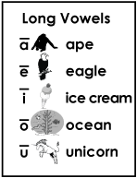
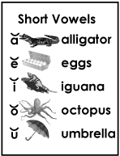
Long and short vowel sounds symbols
A long vowel sound can be shown by a long horizontal line above the vowel as shown to the right.
A short vowel sound can be shown by a short upturned line (similar to a smile) above the vowel as shown to the right.

Slide 9
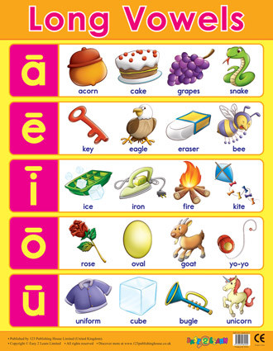
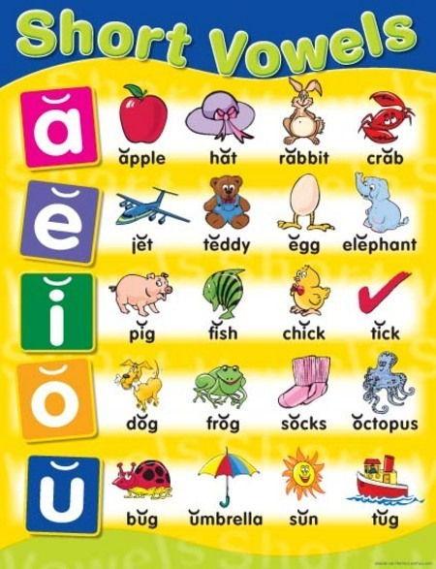
Here are more resources for you to practise with…
…for long vowel sounds
…for short vowel sounds

