Slide 2
What are the seasons ?
There are 4 seasons in the year, spring, summer, autumn and winter. The weather changes with the seasons which affects people, animals and plants. The seasons all have certain characteristics which make each one different.

Slide 3
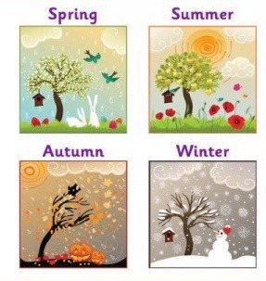
The seasons

Slide 4
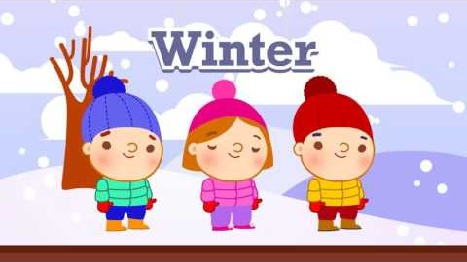
Sing-along with this video

Slide 5
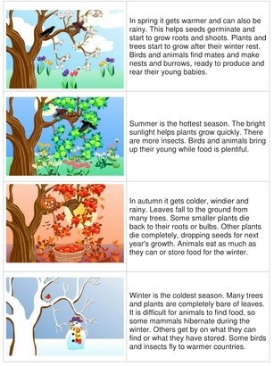
Extra information about the seasons

