Slide 1

Year 6 Curriculum Evening
‘Love your neighbour as yourself.’
PRESENTATION September 2026

Slide 2
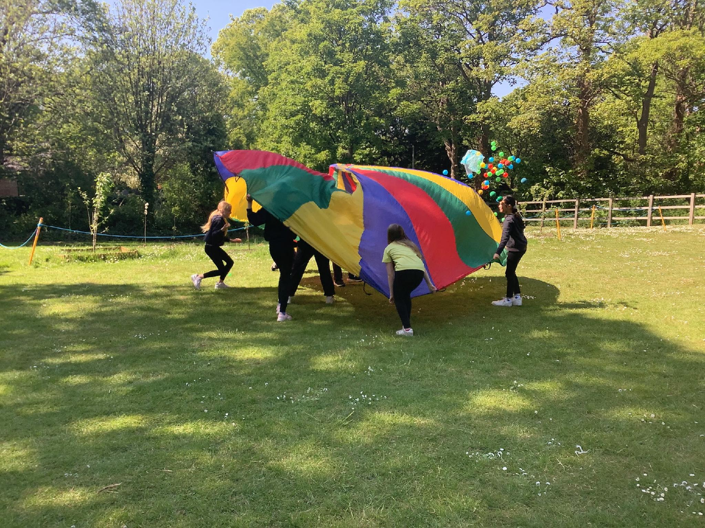
Overview
Welcome to Year 6
Expectations: Mission and Values
Secondary Readiness
Curriculum overview
Robinwood
Communication

Slide 3
Welcome to Year 6
Class Teachers: Mrs McDowall, Miss Job and Mrs Ross
Teaching Assistants: Miss Grisdale, Miss Wootton (Thurs pm)
PPA Teachers: Miss Grisdale and Mrs Longmore

Slide 4
Our Mission and Values
‘Love your neighbour as yourself.’
Luke 10:27
Faith, Hope, Love

Slide 5
RE and Spiritual Development
Wirral scheme for R.E.
Respect and tolerance for all faiths and those of no faith
Celebration of festivals
Concept led curriculum
Collective worship daily

Slide 6
Expectations: Be safe, be ready, be respectful
Homework
  Set on a Wednesday via Google Classroom to be completed for the following Monday.
  English-spelling/grammar (spag.com and spelling frame)
  Maths – maths revision work (paper copies) and/or TT Rockstars
  Home readers
  Paper based homework for English and maths to support transition to secondary from January onwards
PE Kit
  Wear to school each Monday and Friday - school PE kit only
Communication
  Daily through Year 6 comms-admin/absence (generally one-way communication only)
  Please contact the office to arrange meetings or for urgent communication regarding same-day change to pick-up arrangements

Slide 7
Secondary Readiness
Building independence
Developing responsibility for self and others
Acting safely and making the right choices
E-safety
Self-organisation
Time management
Keeping healthy
Acceptance and tolerance
Actions and consequences

Slide 8
Curriculum Overview Autumn-Our World
86tEnglish
  Letters From the Lighthouse , Flanders Field, Once, Rose Blanche
Mathematics
  Mastery approach in line with national curriculum expectations
  Maths No Problem textbooks and workbooks- DFE/ NCETM accredited textbooks
Science
  Electricity
  Light
Wider Curriculum
  Computing-e-safety, advanced internet use/ Spanish / music - Elgar/ PE –tactics and strategies, health and fitness, DT sewing, Art-drawing
  History and geography - World War II and the geographical features of North America

Slide 9
Curriculum Overview Spring-Our Community
English- (A Long Walk to Water, The Island, range of modern and archaic poetry)
Mathematics
  Mastery approach in line with the national curriculum expectations
  Maths No Problem DFE/NCETM accredited textbooks and workbooks
Science
  Humans and other animals
  Evolution and Inheritance
Selected other subjects
  PE –invasion games, dance/ Coding / Music / Spanish / DT – electronically controlled game
  History The Vikings and Geography New York City
  Art - painting

Slide 10
Curriculum Overview Summer – Our Environment
English: Wonder, Macbeth
Mathematics
  Mastery approach in line with the national curriculum expectations
  Maths No Problem DFE/NCETM accredited textbooks and workbooks
Science
  Habitats
Other subjects
  History and Geography focus: The Wirral & Local Area - Coastal Erosion and the contribution of the locality to the World War 2 war effort, Food technology / Spanish, P.E - athletics, computing - website creation
  Art - sculpture

Slide 11
Robinwood November 2nd - 4th 2026
Kit lists have been provided – no new or specialist clothing will be needed other than old, warm clothing and old trainers/walking boots
No technology – including mobile phones – can be brought on the trip
No food is to be brought – the centre provide all our meals and snacks and we must guard against allergies.
It is essential that children have experienced successfully sleeping away for the night prior to the trip.
Although kindly meant, please do not tell your child you can come and pick them up-this stops them settling and is also distressing and unfair for other children.

Slide 12
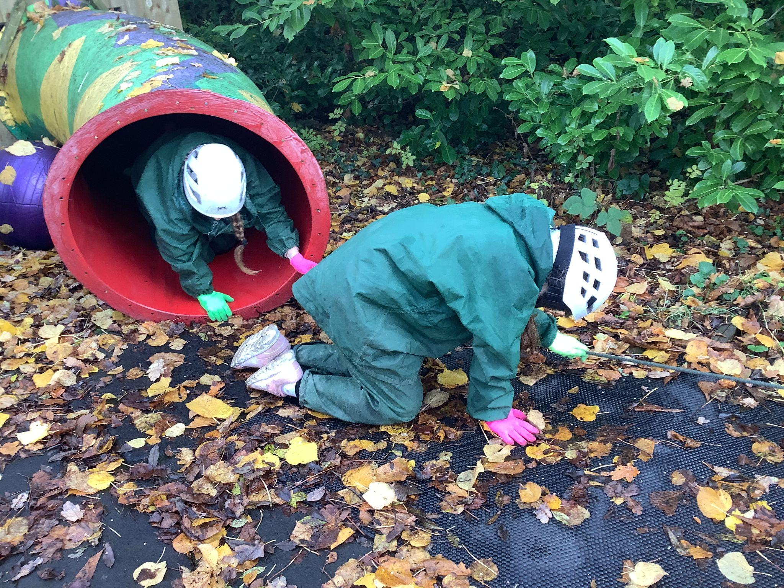
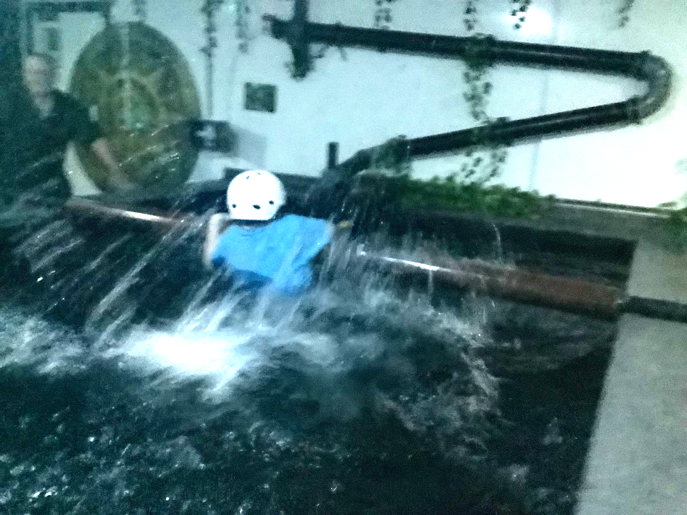
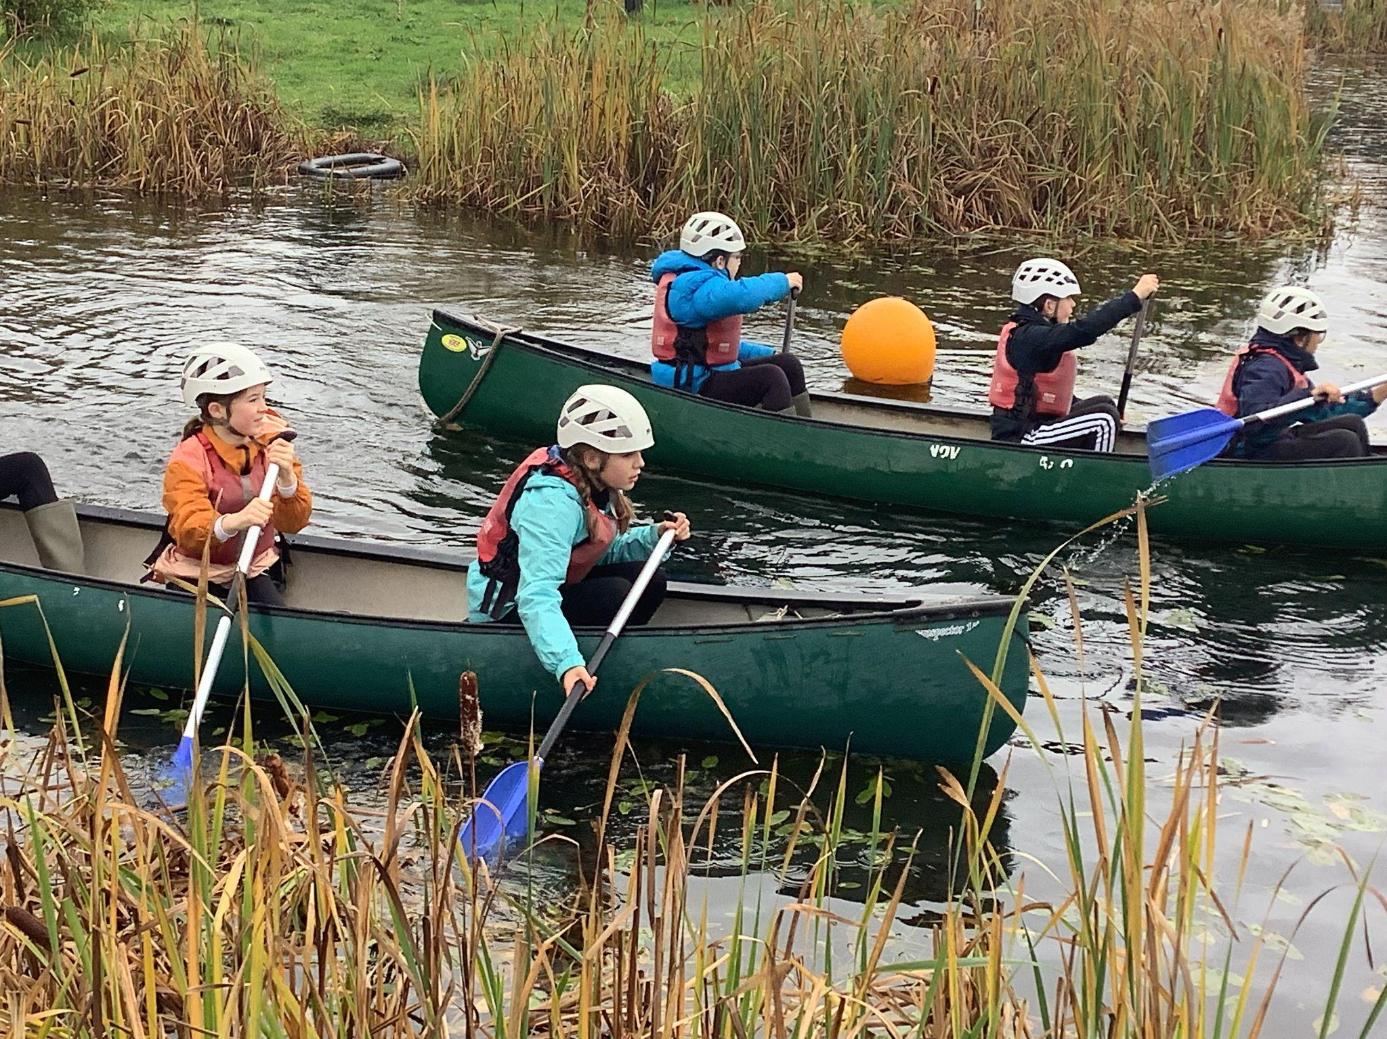
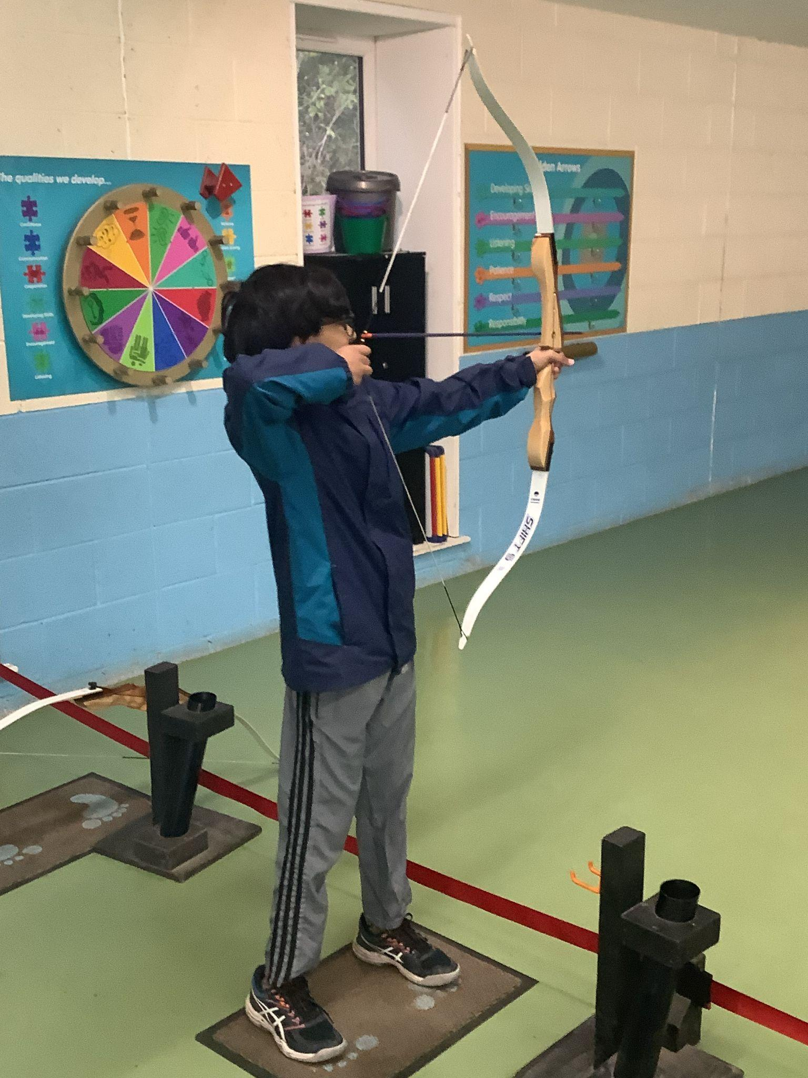
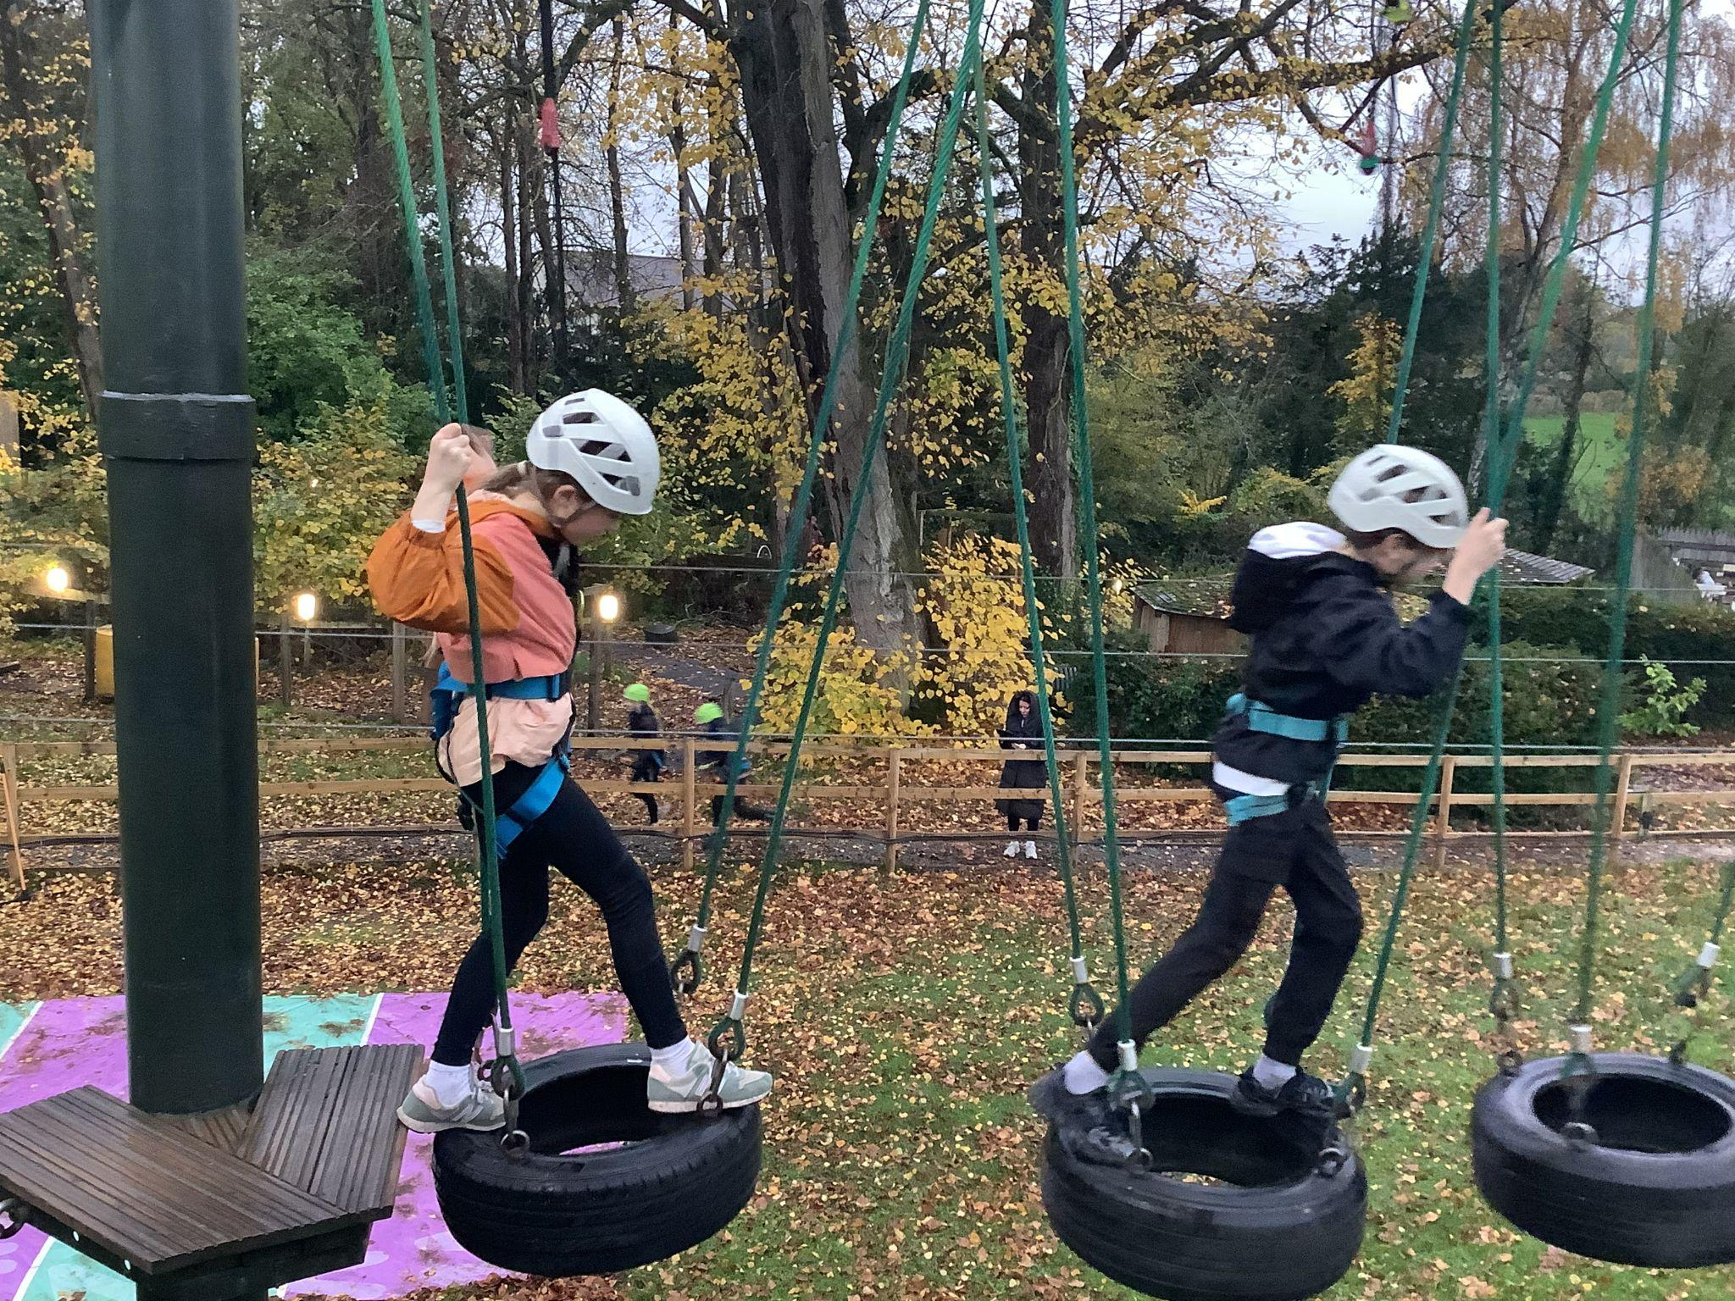
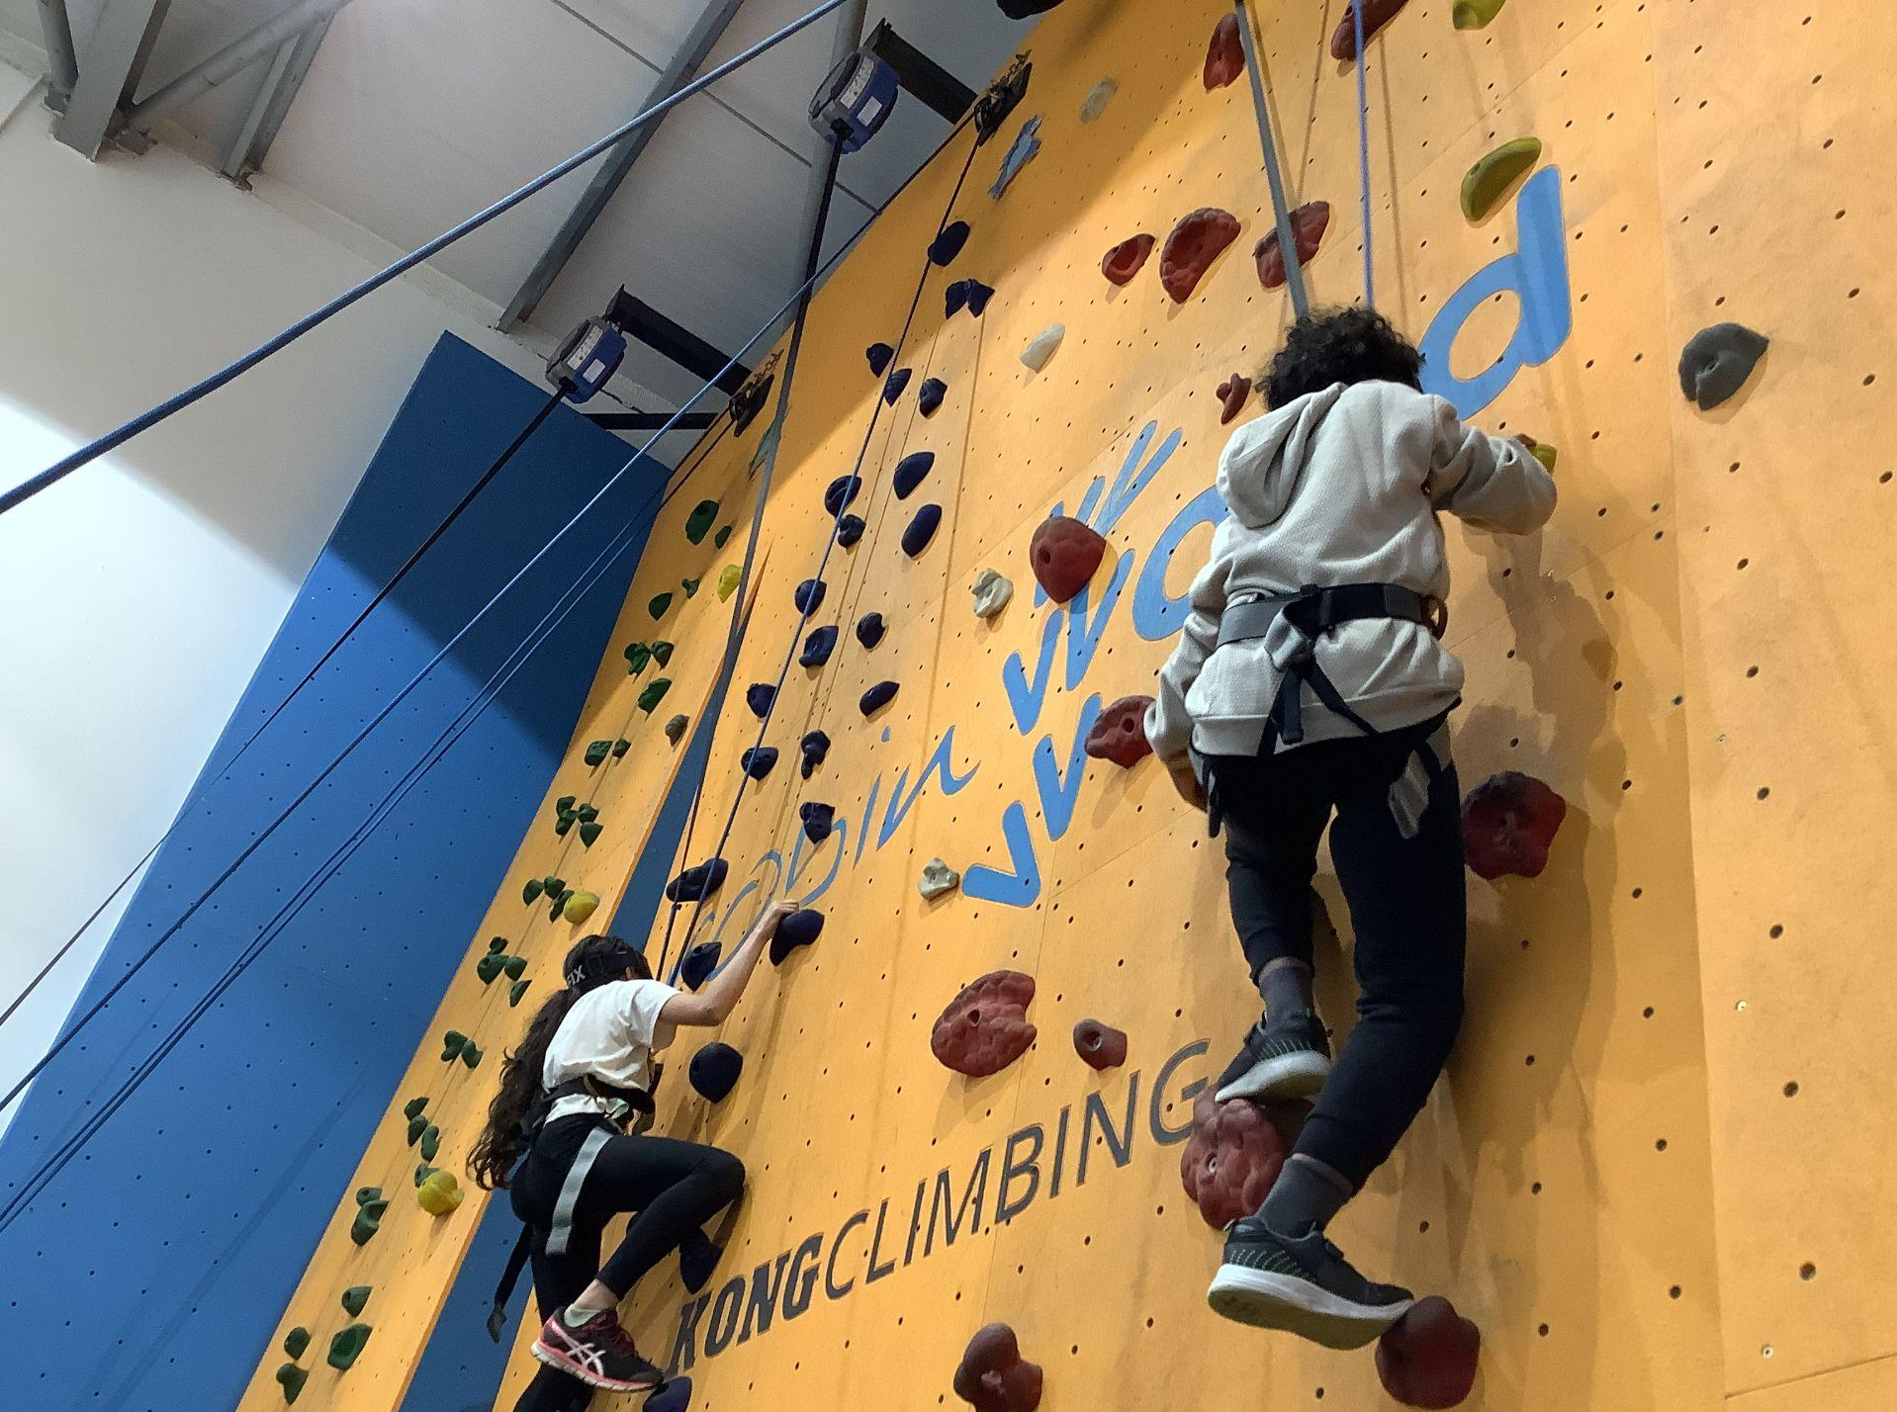

Slide 13
Housekeeping: reminders
Be safe, be ready, be respectful underlines all we do
Water Bottles – please bring in a named refillable water bottle daily
Uniform – please name all items (including PE Kit)
Pencil cases and equipment are provided for all lessons-no need to bring any
Jewellery is not permitted in school except for plain gold and silver stud earrings
Long hair should be tied back for safety and to support learning
PE days – no earrings and long hair tied back please
Playtime snacks – healthy snacks (fruit and vegetables-no chocolate/crisps)
Mobile Phones - new policy means we are a phone-free school
Walking home/change of arrangements–permission must be emailed to Year 6 team in advance

Slide 14
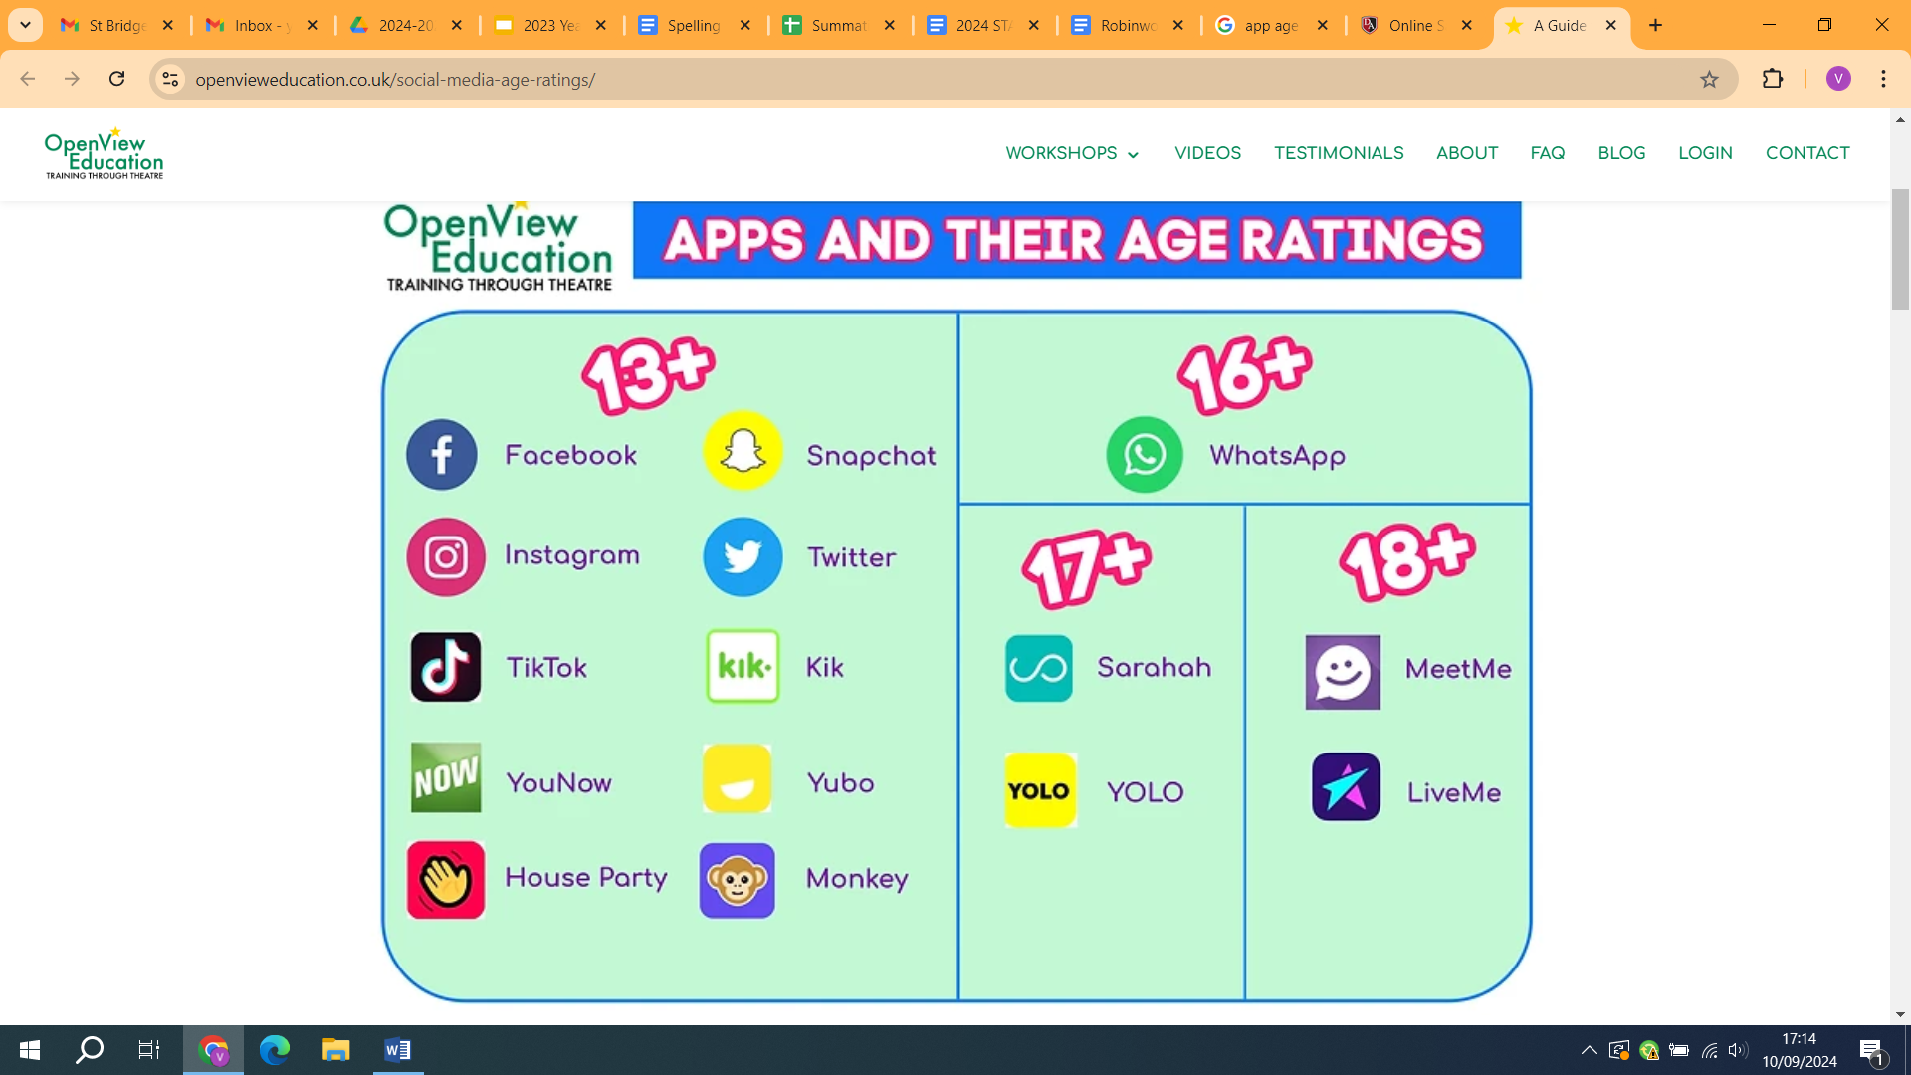
Online Safety
Biggest issue (and growing) is use of
mobile phones
- all of this is outside of school
What’s App groups need to be
monitored regularly

Slide 15
Summer Term Assessments & Transition
KS2 Tests are 10th-13th May 2027 :
Reading, GPAS, Maths (Arithmetic and 2 Reasoning papers)
Writing is moderated and assessed from work across the year
Data is shared with secondary schools
Mental health/ PSHE sessions prepare the children for transition to their new school
Induction day – See Secondary School websites for key information
NO HOLIDAYS CAN BE TAKEN DURING 10th - 13th MAY 2027

Slide 16
Preparing to leave
Transition meetings with secondaries
Appeals: we are only allowed to provide data (not character references) on a standard form. We will provide allocated time for anyone wishing to meet re appeals, but it is the parent not the school who appeals.
Post 11 plus: learning does not stop but is vitally important for secondary transition readiness
Being mindful of late allocation
Being mindful of different feelings about leaving
Focus on celebrating time together and time in school after summer half-term

Slide 17
Thank you
We hope this was useful, please feel free to email any further queries to us and we will get back to you as soon as we can. Thank you for your continued support.
year6comms@stbridgets.wirral.sch.uk

