Slide 1
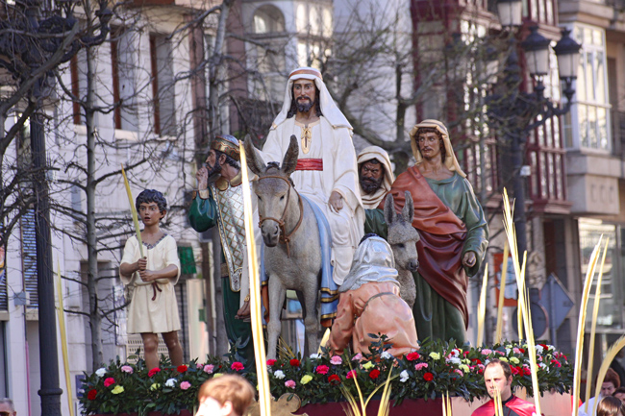
Semana Santa
fecha:
Objective: to learn about Easter in Spain

Slide 2
Learning Success criteria:
All: recognise and understand key events and words to do with Semana Santa
Challenge: give your opinion of Semana Santa and justify it with a reason
Super challenge: create a poster about Easter in Spain

Slide 3
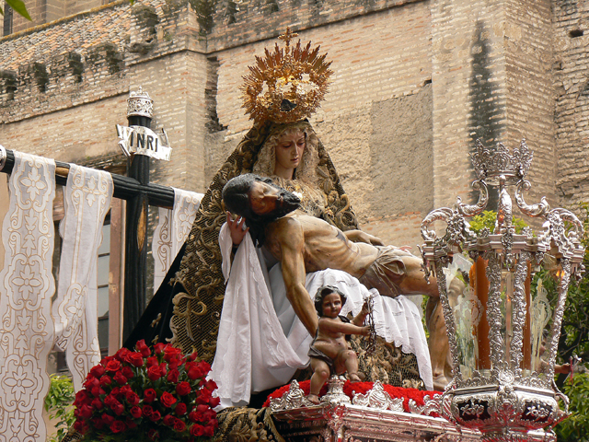
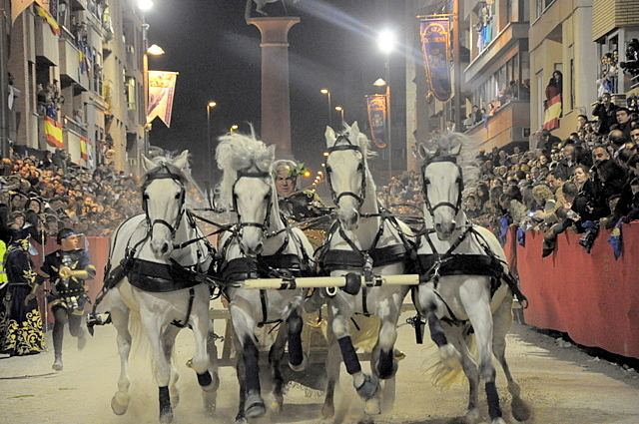
The Spanish word for 'Easter' is Pascua. The seven days leading up to Easter Sunday are called Holy Week, or La Semana Santa in Spanish.
All over Spain, it is a week of spectacular street processions (procesiones) which symbolise the life, suffering and resurrection of Jesus.
Notes:
Up around the room

Slide 4
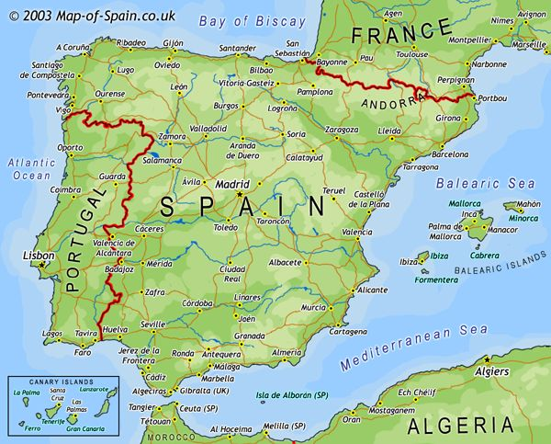
Spain is a mainly Catholic country, so religious celebrations such as La Semana Santa are very important to Catholic followers and are the main events that they celebrate each year.
Notes:
Up around the room

Slide 5
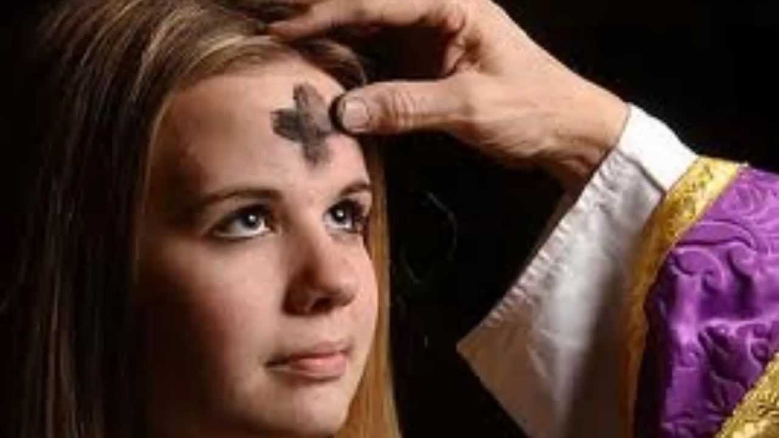
Miércoles de Ceniza is Ash Wednesday and marks the beginning of Lent. La Cuaresma (Lent) lasts for 40 days and 40 nights and represents the time that Jesus fasted before beginning his work for God.
Notes:
Up around the room

Slide 6
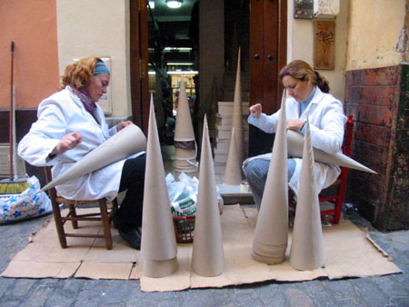
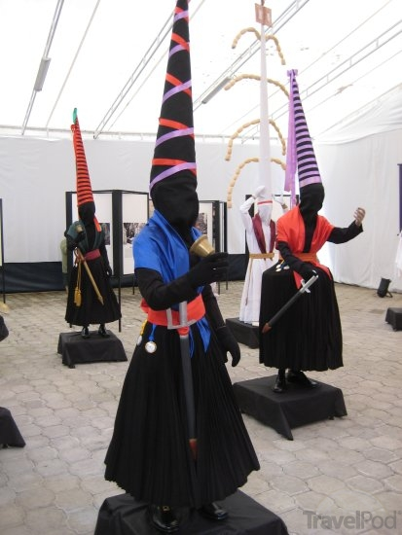
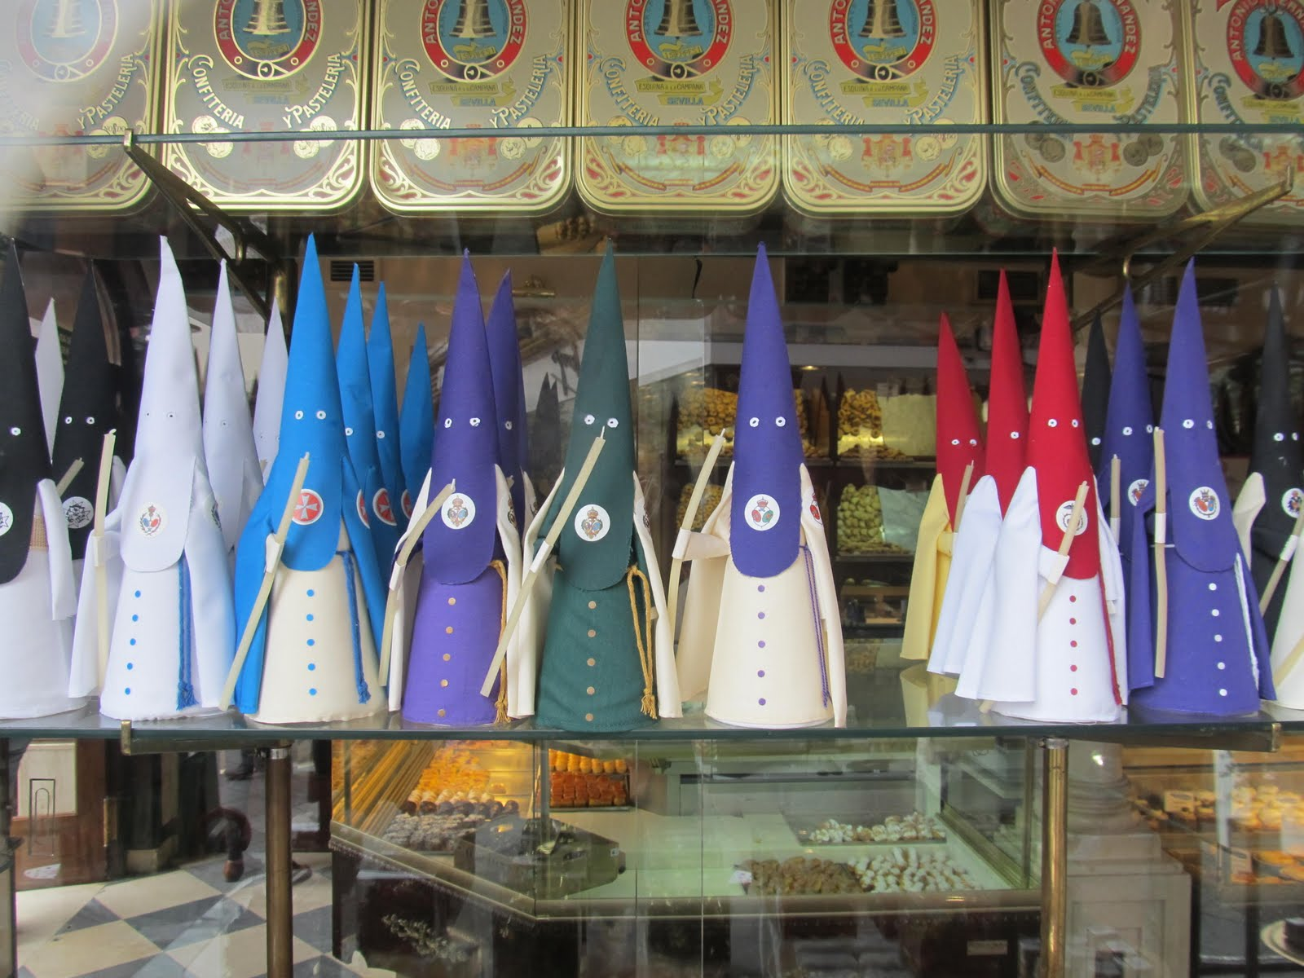
For weeks before Semana Santa, people make costumes and prepare for the parades. You can buy Semana Santa souvenirs, like the ones below.
Notes:
Up around the room

Slide 7
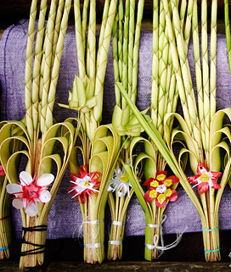
The week starts with El Domingo de Ramos (Palm Sunday) which represents the day that Jesus rode into Jerusalem. On this day Spanish people attend mass at their local church. Children are given palm leaves to symbolise the palms that were throw on the floor when Jesus entered Jerusalem.
Notes:
Up around the room

Slide 8
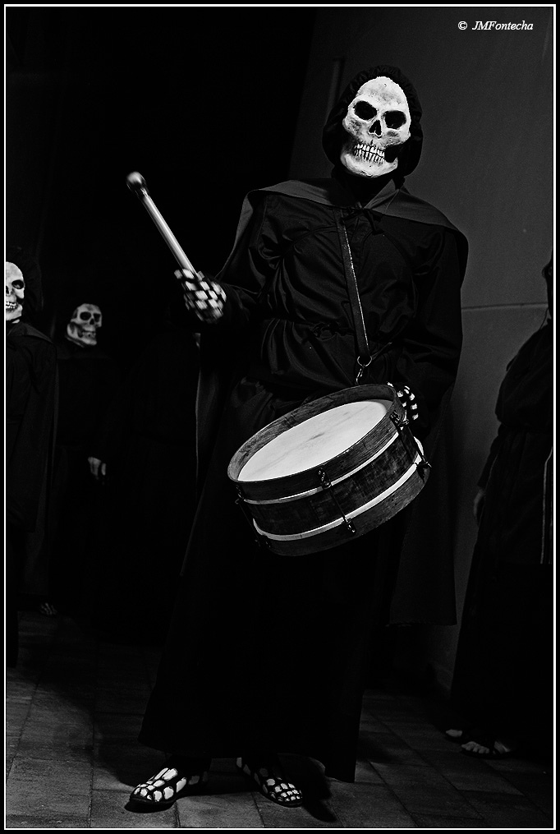
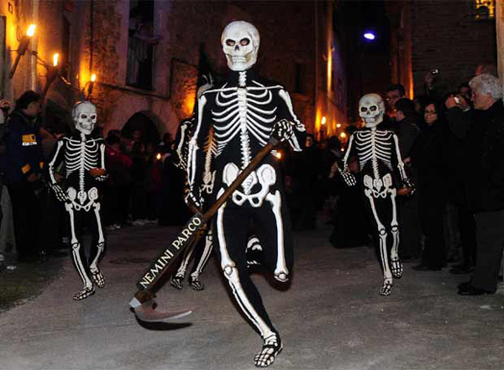
In a town called Verges, North or Barcelona every Maundy Thursday (Jueves Santo) dancers dance ‘La Danza de la Muerte’ (The dance of the dead).
It represents the moment after death when it is decided whether a person’s soul goes to heaven or hell.
Notes:
Up around the room

Slide 9
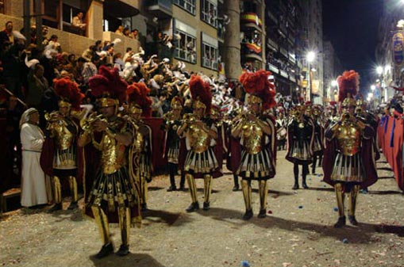
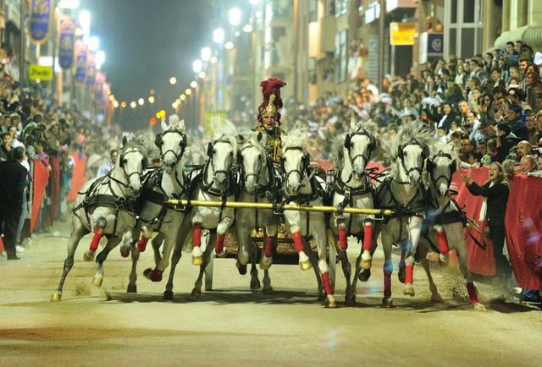
In the town of Lorca in Spain, the parades include thrilling chariot races, vaulting and processions of Roman Soldiers and are all to remember the life of Jesus.
Notes:
Up around the room

Slide 10
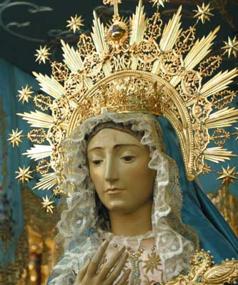
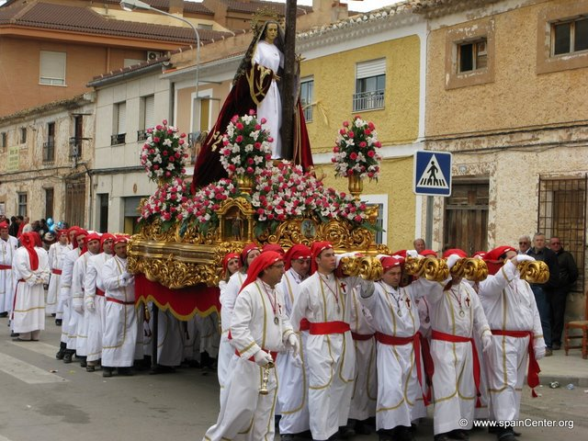
During La Semana Santa, people carry and follow floats, known as pasos. The people that carry the floats are called Costaleros. The floats can be very heavy and sometimes they walk for miles.
On the floats, there are statues of Jesús and La Virgen María. The floats depict scenes of Jesus’s life, and the events leading up to his death.
Notes:
Up around the room

Slide 11
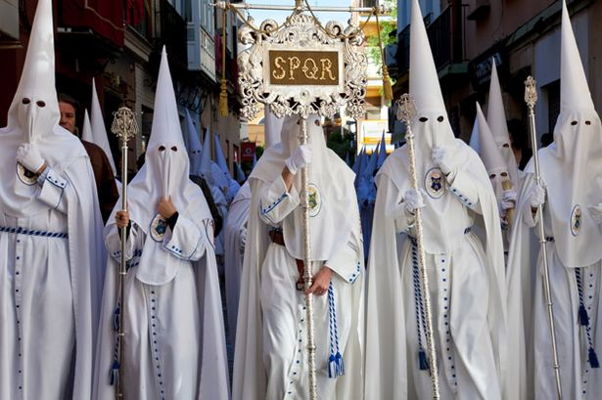
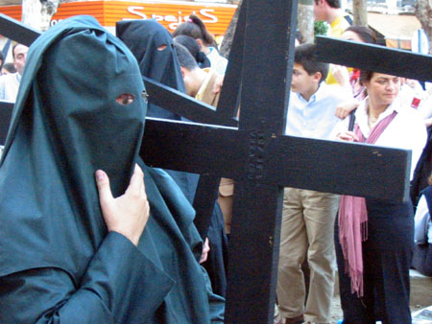
The Nazarenos are the people who follow the floats in the processions. They are also known as the penitentes (penitent ones). The cone shaped hats (capirotes) are meant to make them closer to God. Some Nazarenos carry crosses to represent Jesus’s suffering and death.
Notes:
Up around the room

Slide 12
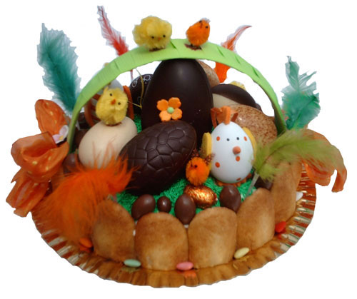
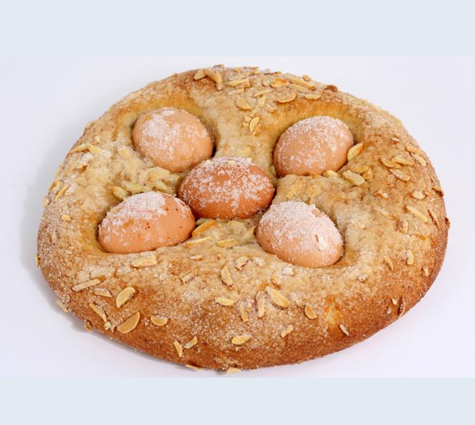
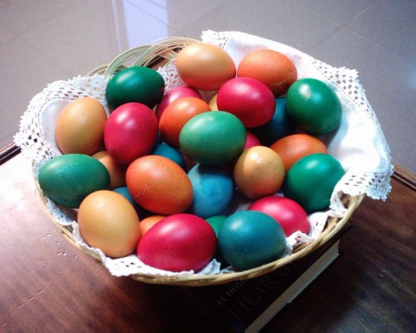
Easter week in Spain is a time of serious processions and remembering the events leading up to and including the death of Jesus.
However, on Easter Day (El Domingo de Resurrección) it is a day of happiness and celebration because on this day the Resurrection of Jesus is remembered.
In recent years the tradition of giving Easter Eggs has really taken off. In Cataluña they eat a special Easter cake called La Mona de Pascua.
Notes:
Up around the room

Slide 13
How do you say ‘Easter’ in Spanish?
What is Holy Week called in Spanish?
What’s the Spanish name for the floats?
What is the name for the people who carry the floats?
When do people start to prepare for Holy Week?
What are children given on Palm Sunday?
What special cake do people buy in Holy Week?
What do the floats usually have on them?
What do the Penitentes carry?
What is Easter Sunday called in Spanish?
What does Holy Week represent?
Why is Easter so important in Spain?
How long does Lent last for?
Name the dance that takes place in Verges on Maundy Thursday?
What does the dance represent?
In the town of Lorca, what other things are included in the processions apart from the floats and Nazarenos?
What’s the name of the pointed hats worn by the Nazarenos?
What does Miércoles de Ceniza translate to in English?
What is Lent called in Spanish?
What is Palm Sunday called in Spanish?
Pascua
symbolise the life, suffering and resurrection of Jesus
Semana Santa
because Spain is a mainly Catholic country
Pasos
40 days and 40 nights
Costaleros
La Danza de la Muerte
Weeks before
The moment after death when it is decided whether a person’s soul goes to heaven or hell.
Palm leaves
La Mona
Chariot races, processions of Roman Soldiers
Statues
capirotes
Crosses
Ash Wednesday
El Domingo de la Resurrección
La Cuaresma
El Domingo de Ramos
Notes:
Answer to running dictation

Slide 14
La Semana Santa: Holy Week
Verbs
Prefiero = I prefer
Pienso que = I think that
En mi opinión = In my opinion
Amo = I love
Me encanta = I love
Me gusta mucho = I really like
Me gusta = I like
Me da igual = I don’t mind
No me gusta = I don’t like
No me gusta nada = I really don’t like
Odio = I hate
Detesto = I hate
Me gustaría = I would like
Es = It is
Son = They are
Hay = There is/are
recordar = To remember
Nouns / Vocabulary
los participantes = The Participants
las bandas de música = Music Bands
los disfraces = The masks / disguises
los eventos historicos = Historic events
el verdadero significado de la Pascua = The true meaning of Easter
los huevos = eggs
una fiesta = A festival
Adjectives
importante = important
interesante = interesting
divertido/ a = fun diferente = different
triste = sad raro/a = strange aburrido/a = boring bonito/a = pretty
aterrador (a) = scary religiosa = religious
Connectives
porque = because y = And también = also muy = Very

Slide 15
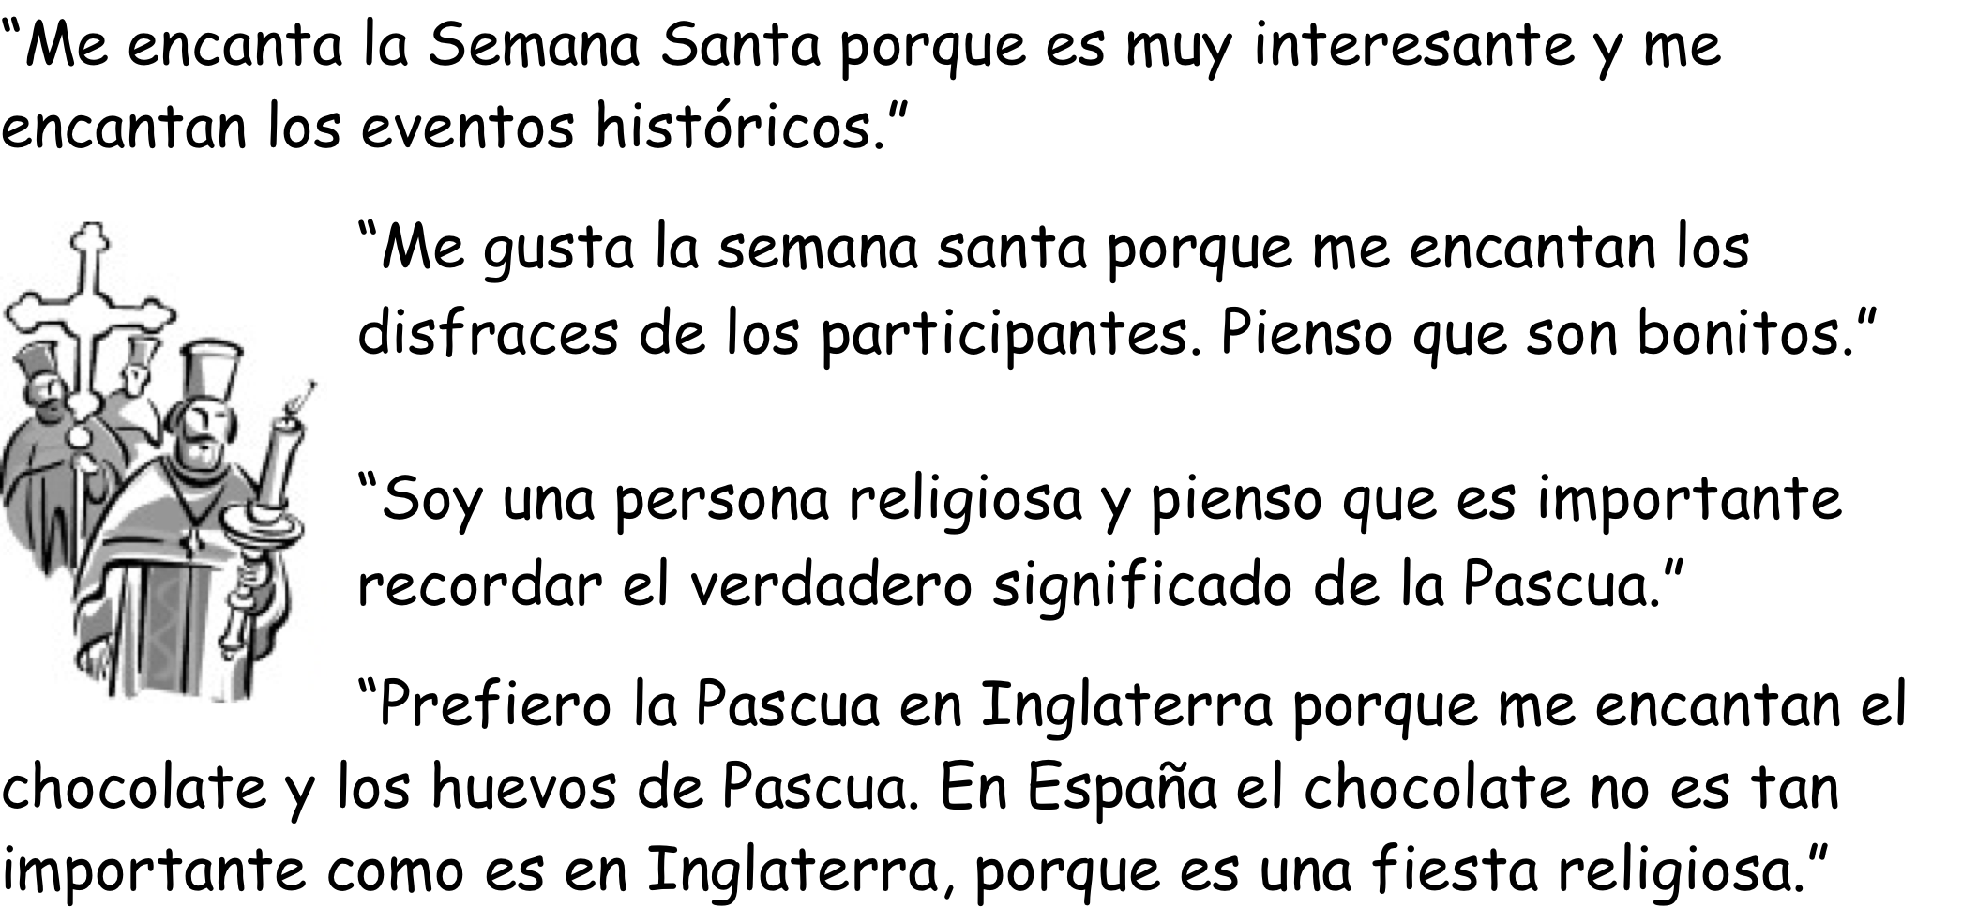

Slide 16
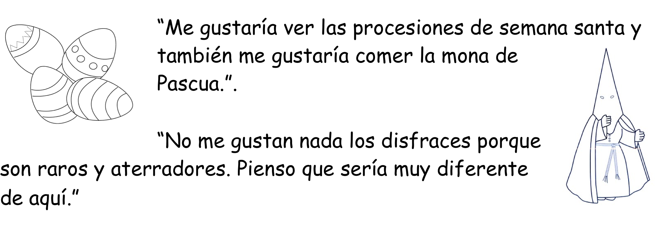

Slide 17
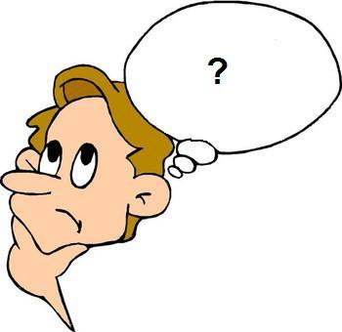
¿Cuál es tu opinión de Semana Santa?
What do you think about Holy Week?
Notes:
Elicit opinions from pupils

Slide 18
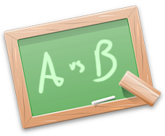
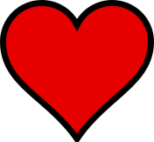
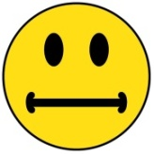
Prefiero
Me encanta(n)
Me gusta(n) mucho
Me gusta(n)
Me da igual
No me gusta(n)
No me gusta(n) nada
Odio / detesto

