Slide 1
Wednesday Phonics

Slide 2
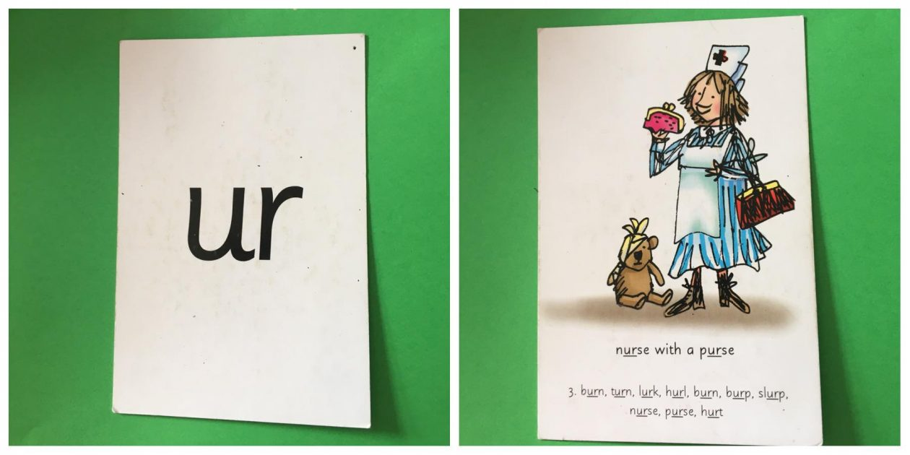

Slide 3
purse nurse hurdle

Slide 4
Look at my pet turtle Clare.

Slide 5
should would could

