Slide 1
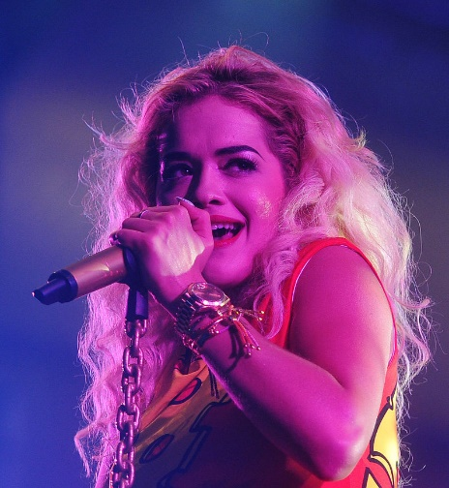
Rita Ora

Slide 2
Rita Ora was born on the 26th November 1990. She is an English singer, songwriter and actress.
Rita was born in Pristina, Yugoslavia (presentday Kosovo), to Albanian
parents. Her mother, Vera is a psychiatrist, and her father, Besnik, is a pub owner, having previously studied economics. Rita has an older sister, Elena, and a younger brother, Don.

Slide 3
Her family left Kosovo because of the war. They relocated to London, England in 1991, when she was a baby, aged one.
She grew up in Notting Hill, in West London and attended St Cuthbert with St Matthias Primary School in Earls Court, following which she graduated from a performing arts school, Sylvia Young Theatre School. She began singing at an early age.

Slide 4
She rose to fame in February 2012 when she featured on DJ Fresh's single which reached number one in the UK.
Her album, Ora, released in August 2012, was at number one in the United Kingdom. Rita was the artist with the most number-one singles in 2012, with three singles reaching the top position.

Slide 6
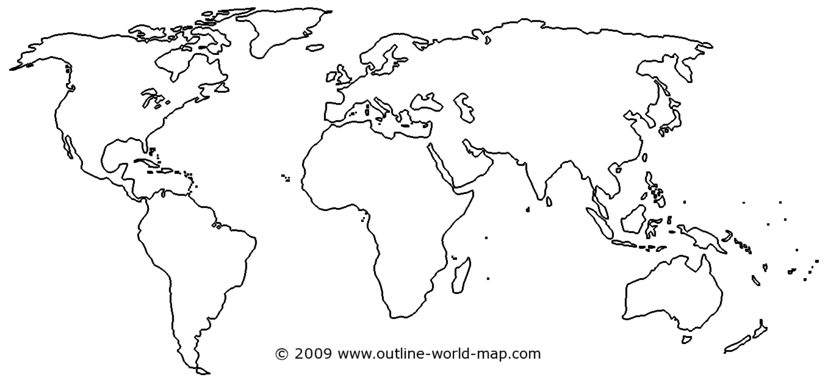

Slide 7
https://www.youtube.com/watch?v=eYL6SRdZ04g

