Slide 1
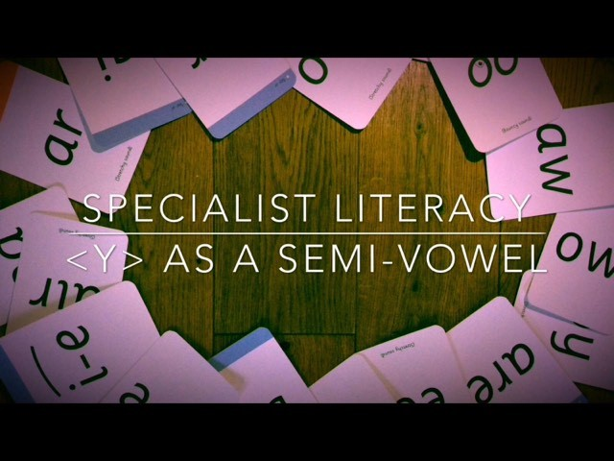

Slide 2
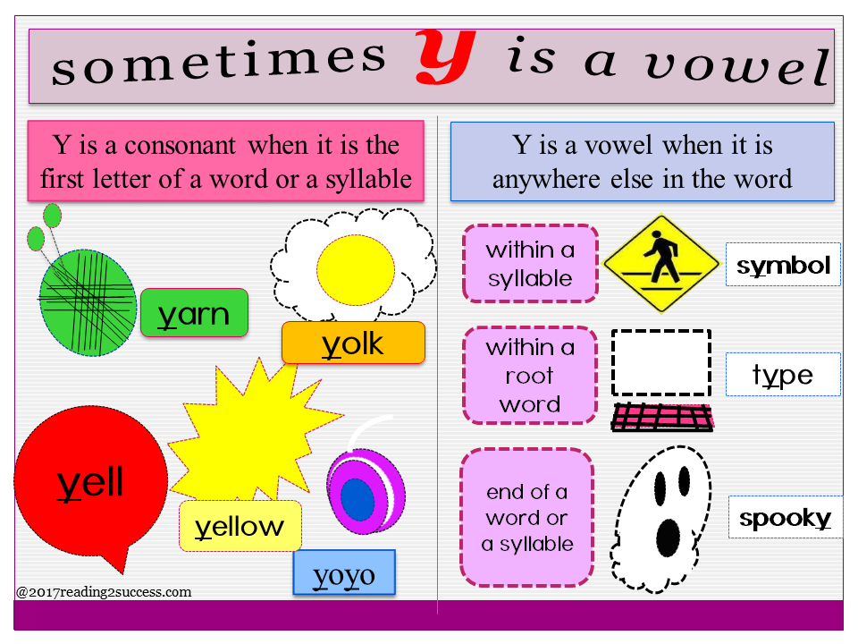
Why the letter y thinks i

Slide 3
Lets try these words
Here’s a list of words where the semi-vowel ‘y’ acts as a vowel

Slide 4

Semi-vowel makes short ‘I’ sound
gym
system
symbol
mystery
crystal
myth

Slide 5
Semi-vowel ‘y’ makes a long ‘e’ sound
party
lady
family
empty
berry
hungry

Slide 6
Semi-vowel ‘y’ as a short ‘I’ sound
cry
fly
spy
reply
magnify
multiply

Slide 7
‘Y’ as a consonant
Y is a consonant when it is at the beginning of the word or syllable, here’s some words to read.
Yell
Yoghurt
Yak
Yet
crayon

