Slide 1


Curriculum Evening
Year 4
September 2026
Presented by Miss James & Miss Smith

Slide 2


Welcome to the
Year 4 Team
Class 8
Miss James
Class 7
Miss Smith & Mrs Knight
Teaching Assistants
Mrs King, Miss McHattie, Mrs Pastor, Miss Wootton

Slide 3
Our School Mission Statement:
Love your neighbour as yourself.
Luke 10. Vs 28
Core Values
Faith, Love and Hope.
1 Corinthians 13:13

Slide 4
School Rules:
Be Safe
Be Ready
Be Respectful

Slide 5

Class Charter
To start the year, as a class, we create a class charter that links to the United Nation Convention of the rights of the Child and our school behaviour rules.

Slide 6
Year 4 Curriculum.
English and Maths
Writing Cycle:
Mon - GPAS
Tues - Active Reading
Wed - Planning
Thurs - Writing
Fri - Editing
Maths:
Mastery Maths - Maths No Problem - Textbook & Workbook
Fluency/ Automaticity - Mastering Number, daily times tables and maths problems (NCETM) - MTC (June)

Slide 7
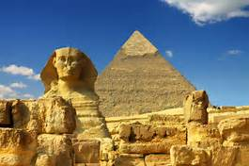
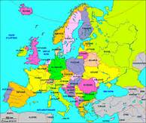
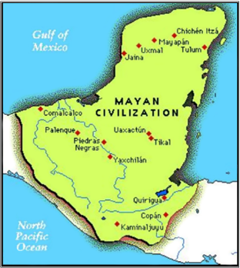
Year 4 Curriculum.
Autumn Term – Connecting with our World
Ancient Egypt
The United Kingdom: Land Use
Christmas Service
Spring Term – Connecting with our Community
STEAM
Social justice
Swimming
Summer Term – Connecting with Our Environment
The Maya
Local Area
School Sleepover/residential (TBC)

Slide 8
RSE
At the end of the year, the boys and girls will separately learn about how their bodies change.
These are things we cover:
Hygiene, emotions, body hair, periods(girls) and changes of the body.
The videos that stimulate our conversations are sent out prior to this lesson.

Slide 9
Trips and Visits
Autumn term- Liverpool World Museum
Spring term- Swimming & Library Visit
Summer term- River: Port Sunlight River Park, Residential (TBC)
Several visits throughout the year from Hi-Impact (Science, DT and Computing)

Slide 10
Things to remember everyday:
water bottles
no need for own pencil cases
labelled uniform
healthy snack for morning break times

Slide 11
Physical Education
Hair tied back
Earrings taken out- policy
PE kit- dark tracksuit, yellow PE top and trainers
Days - Tuesday (PE) and Monday (Games)

Slide 12




Homework
Online tasks will be set every MONDAY to be completed by the following Monday.
Spelling Frame and paper copy (for handwriting)
TT Rockstars
Spag.com (not every week)
Make sure you check Google Classroom each week for updates/ projects.

Slide 13
Homework
Reading books
We encourage children to read a variety of literature, both their school book and others of their own choosing. Any reading can be recorded in their Reading Logs. Books must be signed off before the children change their own book on the following days:
Monday – Ashton
Tuesday – Beacon
Wednesday – Hilbre
Thursday – Marine
Friday - Shore

Slide 14
How can you help at home?
Read for 10 minutes everyday, this does not always have to be their school reading books. Ask questions to check understanding and inference.
In Year 4, children will learn 6x, 7x, 9x, 11x and 12x tables and when ready, division facts for these tables. When all tables are learnt, soundcheck on TT Rockstars is very useful. ANY and ALL times table practise is useful.
In June there will be a Statutory Times Tables Test that all children have to complete online.
Practise telling the time.
CEW (see next slide and the hand-out to take home)

Slide 15
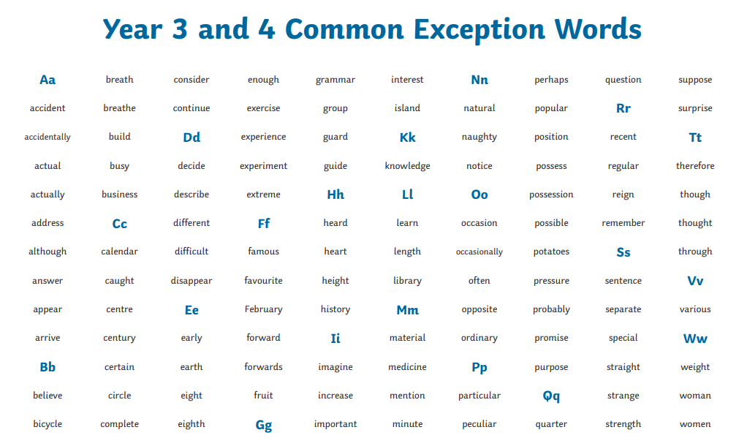
How can you help at home?
Practise the 109 Year 3 & 4 Common Exception words.

Slide 16

E-safety
Keep your personal stuff private and
think about what you say and do online.
Remember that people online may not be who they say they are. Online friends are still strangers even if you have
been talking to them for a long time.

Slide 17
MTC
The Year 4 Multiplication Tables Check (MTC) is a quick, national assessment taken by 8- and 9-year-old primary school children in England every June. Its purpose is to check whether children can quickly and accurately recall their times tables up to $12 \times 12$.
How the Test Works
Format: It is taken on a tablet, laptop, or computer at school.
Length: It takes around 5 minutes.
Questions: There are 25 questions selected at random from the 2 to 12 times tables.
Time Limit: Children get 6 seconds to read, type, and submit the answer to each question, with a 3-second gap in between.
Focus: The test gives more weight to the trickier tables—such as the 6, 7, 8, 9, and 12 times tables—rather than easier ones like 2s, 5s, or 10s.
Key Points for Parents
There is no "pass" or "fail" mark. It isn't a high-stakes exam. Instead, it generates a total score out of 25 that is shared with your child's school and included in their end-of-year school report.
It measures automatic recall. The 6-second timer means there is no time to count on fingers. The goal is for your child to know the facts instantly so they don't get stuck on basic multiplication when tackling harder maths in Years 5 and 6.
It only tests multiplication. There are no word problems, division questions, or multi-step sums—just straightforward multiplication (e.g., $7 \times 8 = ?$).
How to Help at Home
Short, daily practice: Practising for 5 minutes a day is far more effective than an hour once a week.
Focus on random recall: Don't just practice in order ($6, 12, 18, 24\dots$). Ask questions out of sequence so your child recognises the fact on its own.
Use digital tools: Schools usually give children access to apps like Times Tables Rock Stars (Soundcheck mode) or online practice sites (like Mathsframe or the official DfE practice site) that mimic the exact 6-second timer format.

Slide 18
E-Safety
Keep your personal stuff private and
think about what you say and do online.
Remember that people online may not be who they say they are. Online friends are still strangers even if you have
been talking to them for a long time.

Slide 19
Communicating with us…
Urgent messages – Contact school office
Non-urgent messages or questions – Contact
year4comms@stbridgets.wirral.sch.uk
Messages to this email are unlikely to be picked up after 1:00pm. This is a one way communication.

Slide 20
PTA
The PTA is dedicated to aiding the entire learning experience of all the children here at school as well as helping the school become a fully integrated part of the local community.
Summer Fair
Christmas Cards
Christmas Discos
Raffle boxes
Class Photographs

Slide 21
Thank you for your attendance, this evening’s slides will be available online.

