Slide 1

Curriculum Evening
Mission statement;
“Love your Neighbour as Yourself”
School core values; Love, Faith, Hope.

Slide 2
RE
Chester Diocese and Wirral schemes
Respect and tolerance for all
Understanding and expressing my growing beliefs and values
Celebration of all festivals (Year 1 Christmas service; 20th December 1.45pm in church)
Collective worship- whole school assemblies, class assemblies, Golden Merit and Clergy.

Slide 3
Expectations: Be safe, be ready, be respectful
Weekly overviews of learning will be updated every Friday via Tapestry.
Homework; set on a Friday via Tapestry. Reading books sent home on a Monday to be returned on a Thursday. RWI book to be sent home a Friday to be returned on a Monday. Mathletics will be set weekly and linked to prior learning. Spring 2 Introduce SPAG.
PE kit; to be worn every Tuesday and Thursday, long hair tied up and no ear rings to be worn on PE days.
Communication; absences via school office not comms. Changes in daily pick up/messages can be sent via comms. However, messages sent after 12.00pm maybe missed.

Slide 4










Behaviour system

Slide 5

Phonics
Daily sessions using Read Write Inc, your child will then receive books/words to practise at home that contain the sounds learnt that week. There will also be a focus on the reading of real and non real words.
Activities include;
- partner work
speed sounds, word and sentence generation
Special friend, Fred Talk, read the word.
Child friendly – the children love Fred the frog!
https://www.youtube.com/watch?v=TkXcabDUg7Q

Slide 6

Reading with your child – how you can help.
Read with your child each night and use phonic ‘blending’ strategies to decode unfamiliar words. Eg m/i/l/k or sh/ee/p. We call this Fred Talk. Once the children have decoded the words in a sentence it is good practise to reread the sentence for fluency.
Discuss the text with your child.
We will be reading with your child every day during our phonic sessions.

Slide 7

Reading with your child – Active read
We have a specific Active read lesson each week to teach the children the skills.
Prediction-what happens next
Inference-read between the lines
Language-new vocabulary and punctuation
Sequencing-retelling the story and ordering key events
Examples of questions you could ask:
What do you think would happen if?
Why do you think they said that?
How were they feeling?
Was the dog feeling happy? Why?

Slide 8

Maths
Mastery approach in line with the National Curriculum expectations.
Use of resources/manipulatives
Journaling
Workbook

Slide 9
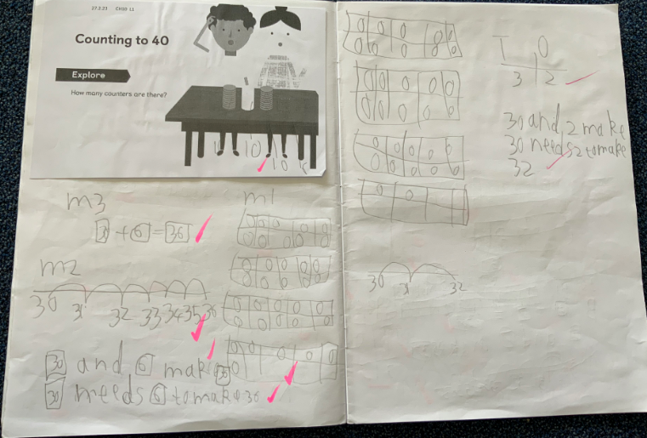

Slide 10
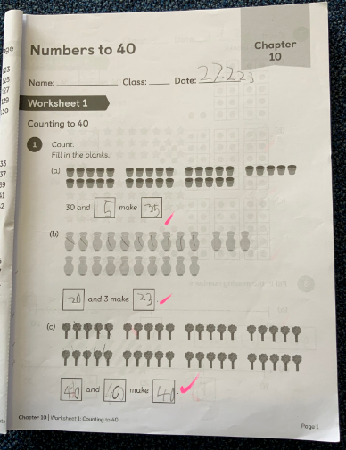
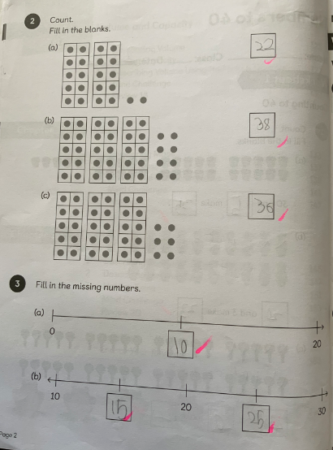

Slide 11
Curriculum Overview Autumn; Our World-
Please see our website for termly updates.
Our sessions are linked to a high quality text to engage the children.
The Gruffalo, Trouble with Trolls, One Day on Our Blue Planet in the Antarctica, One Day on Our Blue Planet in the Savannah. The night before Christmas.
English lessons are linked.
Science-
Animals and humans- Senses.
Materials
Seasonal weather
Wider curriculum
Computing unplugged algorithms, coding
Music; Harvest, Christmas- pitch, rhythm and expression
PE-dance animals, fundamental skills, dance castles-attacking and defending, games delivered by Edsential and class teacher
DT; stable structure-battering ram or throne, designing and appraising
ART; Iris Scott- investigate, explore and create
History and Geography-explorer, Battle of Hasting, Norman Invasion.

Slide 12
Curriculum overview Spring; Our Community
English: Beegu, Great Woman Who Change the World, Little People-Big Dreams.
Science:
Materials
Seasons
Plants
Wider curriculum
PE-Gymnastics, Tennis skills, health and fitness
DT- levers
Art Paul Klea- investigate, explore and create
Music-
Social Justice-refugees
History and Geography; famous scientists, map work, Physical and human features, compass directions

Slide 13
Curriculum Overview Summer; Our environment-
Please see our website for termly updates.
English; Our local area; Owl babies. Someone Swallowed Stanley, Flotsam..
Science-
Animals and humans. Environments. Country code.
Wider curriculum
Computing- pic collage/texts, uploading photographs to apps, digital media, saving work, keyboard work
Music
PE- health fitness, athletics
DT- Food healthy breakfast pot
ART-sculpture Anthony Gormley, Beacon column
History and Geography- Ashton Park, St Bridget’s school, St Bridget’s church, West Kirby

Slide 14
House keeping: reminders
Be safe, be ready, be respectful underlines all we do.
Water bottles to be named and filled each day.
Uniform to be named.

Slide 15

E-Safety
E-Safety is monitored by the authority to ensure children and adults can’t access certain sites.
When working on the iPad children know to only access the apps on the iPad.
Are you aware of what your child is accessing at home?

Slide 16

Heartsmart 5 principles
See our school website for more information

Slide 17
year1comms@stbridgets.wirral.sch.uk

