Slide 1
Year 1 Whole Class Reading

Slide 2
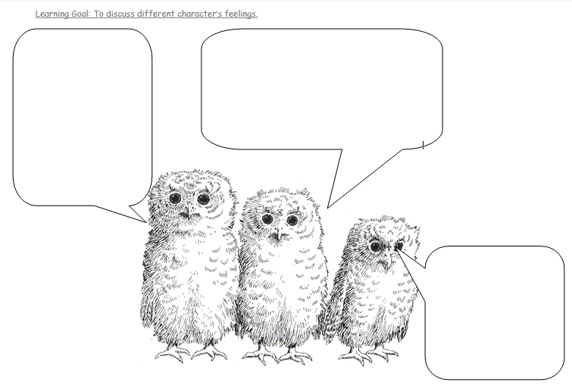
Week 1

Slide 3
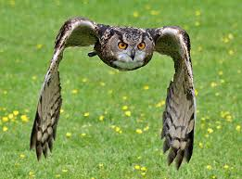
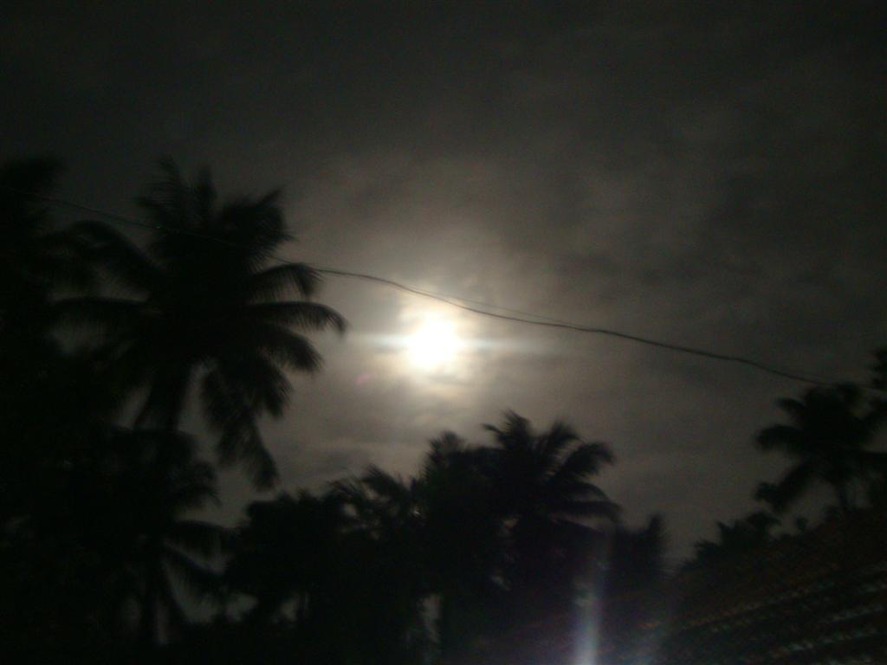
Week 2
swooped
Moving downwards through the air.
silent
Not making a sound.

Slide 4
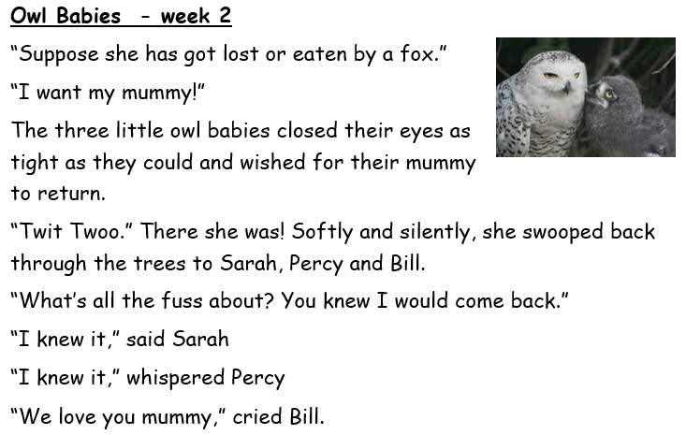
Notes:
Echo Read, then Choral read part or all of this.

