Slide 1
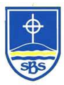
Welcome to Year 3’s Curriculum Evening
Class 5 – Mrs Ashton and Mrs Darby (Fridays)
Class 6 – Miss Segar
TAs - Mrs Carrol-Vickers, Mr Green and Mr Winston

Slide 2
Love your neighbour as yourself.
Luke 10:27.
Our School Mission Statement

Slide 3




Faith, hope & love.
1 Corinthians 13:13
Core Values

Slide 4
School Rules:
Be safe
Be ready
Be respectful

Slide 5

Class Charter
To start the year, as a class, we create a class charter that links to the United Nation Convention of the rights of the Child and our school behaviour rules.

Slide 6
Curriculum
Continuing from Year 2:
Read, Write, Inc
Maths No Problem
GPAS
Active Read
Science
Foundation Subjects
Morning Maths
New in Year 3:
Spanish
Chess – every week.
Swimming – Autumn 2
Class 5- WC 2/11/26
Class 6- WC 9/11/26
https://www.stbridgets.wirral.sch.uk/website

Slide 7
Year 3 Curriculum: English and Maths
Writing Cycle:
Mon - GPAS
Tues - Active Reading
Wed - Planning
Thurs - Writing
Fri - Editing
Maths:
Mastery Maths - Maths No Problem - Textbook & Workbook
Fluency/Automaticity - Mastering Number and Morning Maths work

Slide 8
Whole School Topics
Autumn - Connecting with our World- Stone Age to Iron Age. The United Kingdom: Countries and Cities.
Spring - Connecting with our Community –
STEAM and Social Justice. Easter Service.
Summer - Connecting with our Environment –
Our Local Area - The Anglo-Saxons. The River Dee.

Slide 9
Curriculum Expectations
The jump from Key Stage 1 to Key Stage 2:
  Timings and stamina
  National Curriculum
  Organisation
  Handwriting-cursive
  Flair-wider range of punctuation-sentence writing

Slide 10
Trips and Visits
Autumn term- Calderstones Hertiage Park (TBC) and swimming
Spring term- Bespoke Personal Best Activity- Bidston Tennis Centre and Library Visit
Summer term- River Dee-Thurstaston
Several visitors throughout the year from Hi-Impact (Science, DT and Computing)

Slide 11
Things to remember everyday:
water bottles
no need for own pencil cases
labelled uniform
healthy snack for morning break times
No fidgets

Slide 12
Physical Education
Hair tied back
Earrings taken out- policy
PE kit- dark tracksuit, yellow PE top and trainers
Days - Wednesday (PE) and Thursday (Games)

Slide 13
Homework
Online tasks will be set every FRIDAY to be completed by the following FRIDAY (before school).
Maths/GPAS paper activity-retrieval of learning
Spelling Frame and paper copy of spellings
Spag.com
TT Rock stars
Make sure you check Google Classroom each week for updates/ projects.

Slide 14
Reading Books
We encourage children to read a variety of literature, both their school reading books and others of their own choosing. Any reading can be recorded in their Reading Logs.
Books must be signed off for it be changed.
Reading books are to be brought into school by Wednesday and will be returned on Friday.

Slide 15
Helping at home
Reading – Read for 10-15 minutes everyday, this does not always have to be their school reading books. Ask questions to monitor and check understanding and develop inference skills.
Maths – In Year 3, children will learn their 3, 4 and 8 times tables and corresponding division facts for these tables. Consistent revision and overlearning of their 2, 3, 4, 5, 8, and 10 times tables will benefit the children.
- Number Bonds
- Counting in 3, 4, 8
- Time and money
Spelling and Reading Common Exception Words

Slide 16
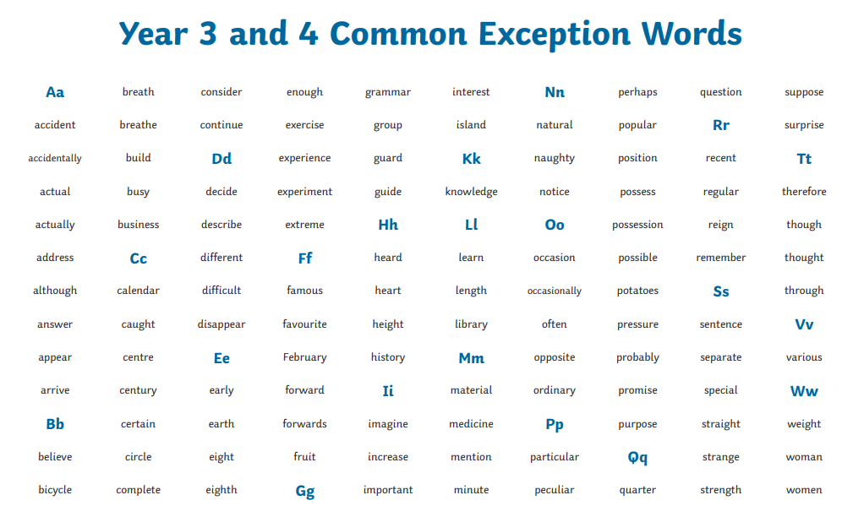
How can you help at home?
Practise the 109 Year 3 & 4 Common Exception words. We also practise the 109 Year 1 & 2 Common Exception words.

Slide 17
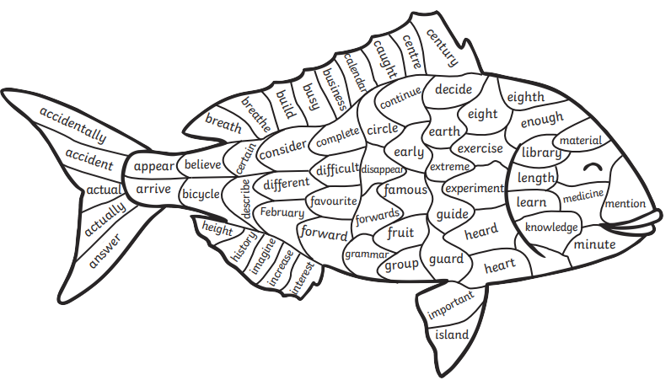
Helping at home
Practise the Year 3 and 4 Common Exception words.

Slide 18
E-safety
Keep your personal stuff private and
think about what you say and do online.
Remember that people online may not be who they say they are. Online friends are still strangers even if you have
been talking to them for a long time.

Slide 19
Communication
Urgent messages – Contact school office
Non-urgent messages or questions – Contact
year3comms@stbridgets.wirral.sch.uk
Messages to this email are unlikely to be picked up after 1:00pm. This is a one way communication.

Slide 20

YOUR PTA
The PTA is dedicated to aiding the entire learning experience of all the children here at school as well as helping the school become a fully integrated part of the local community.
Summer Fair
Christmas Cards
Christmas Discos
Raffle boxes
Class Photographs

Slide 21
Thank you for coming to Year 3’s Curriculum Evening, this evenings slides will be available on the school website.

