Slide 1
Foundation 2
Curriculum Evening
General information.
September 2023

Slide 2
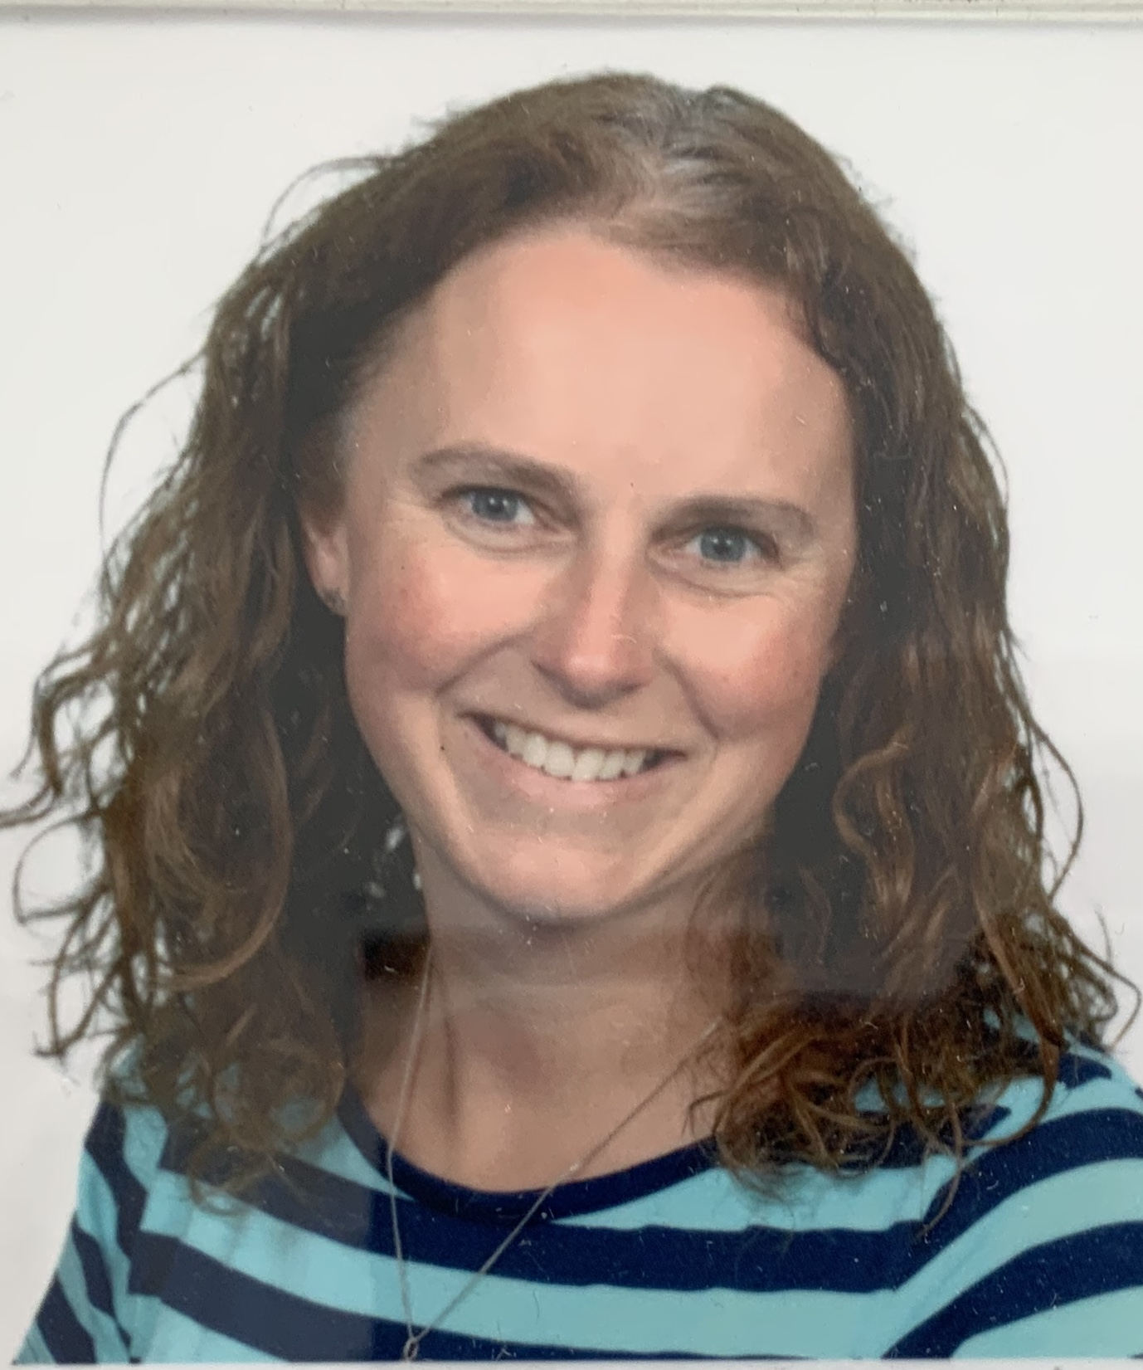
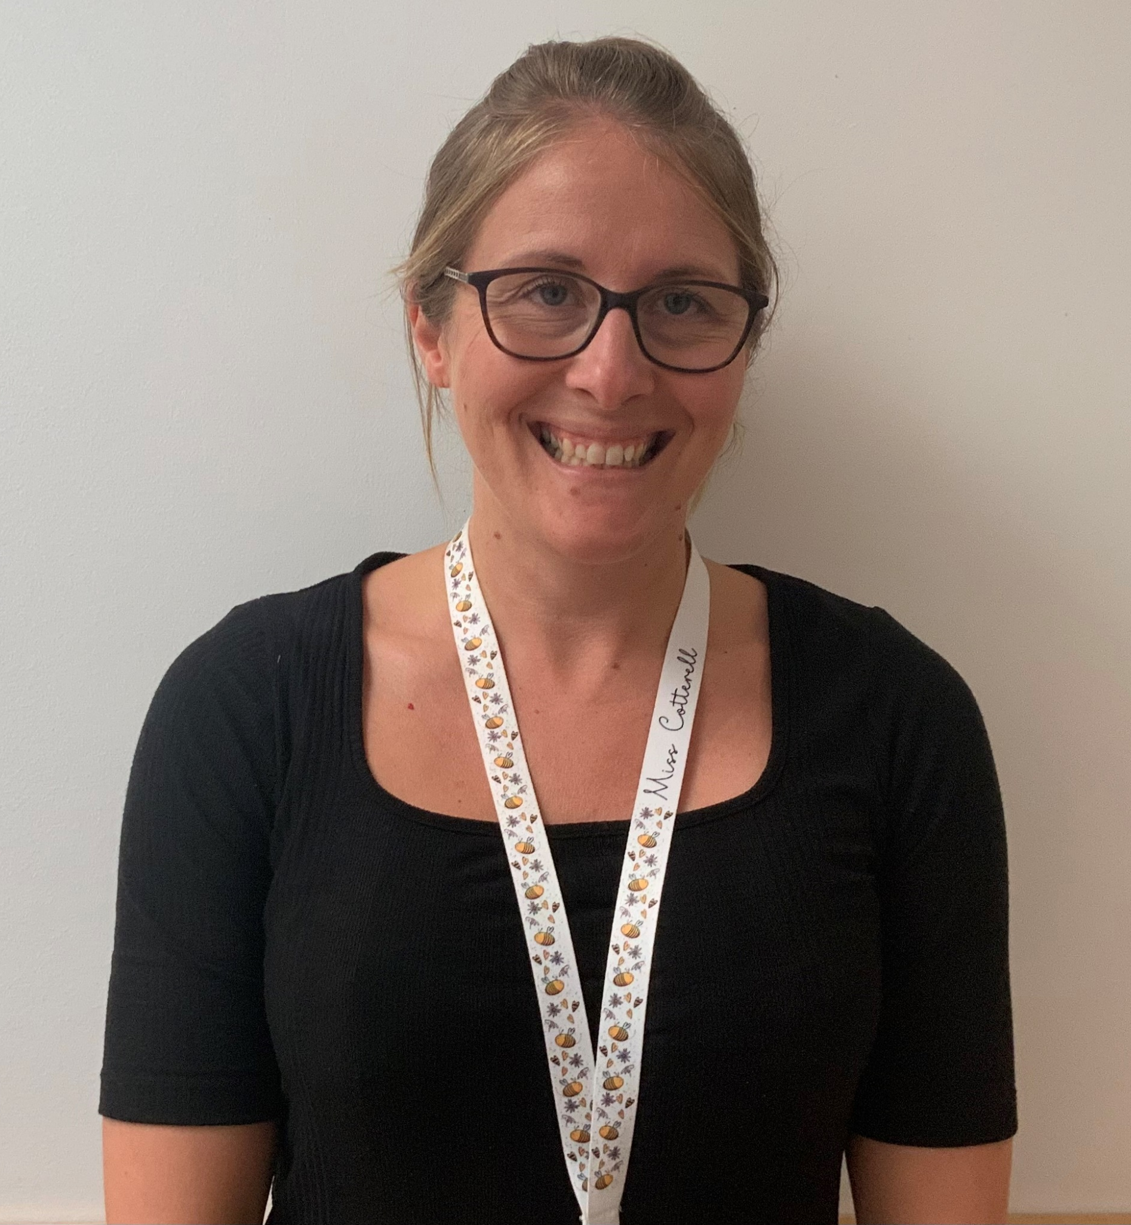
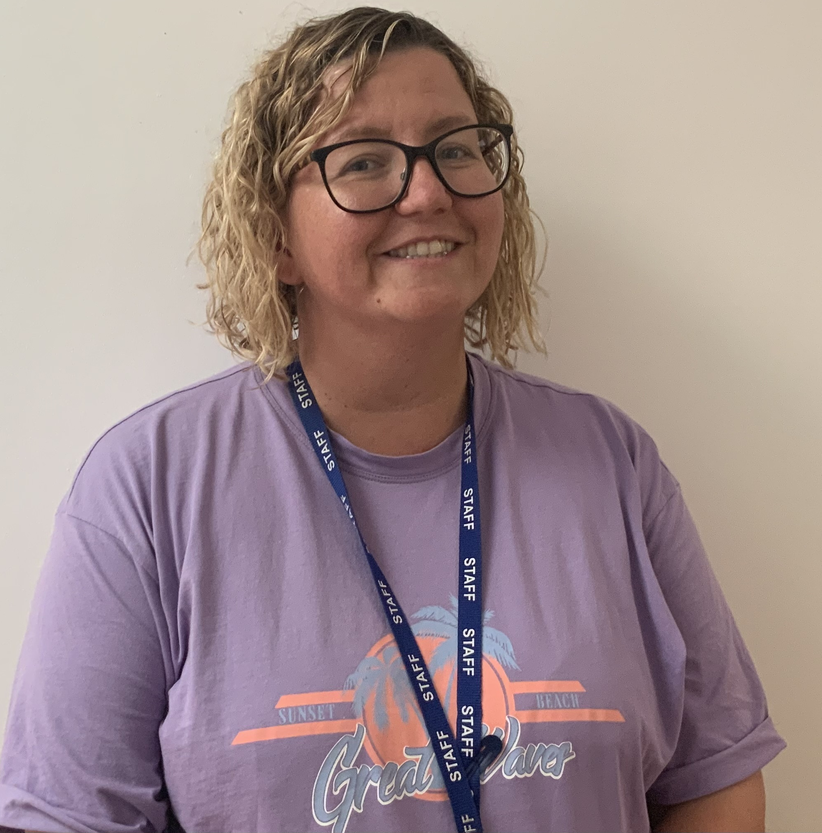
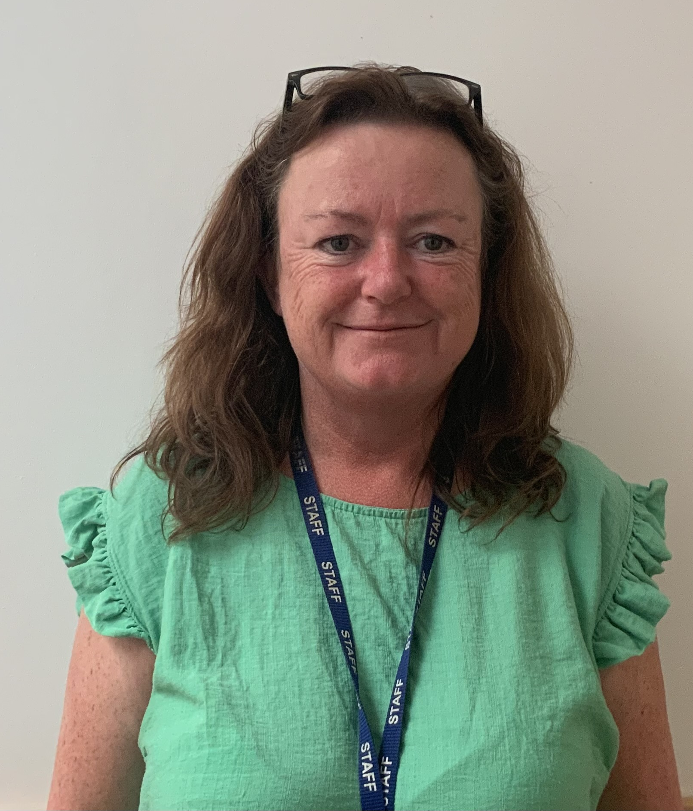
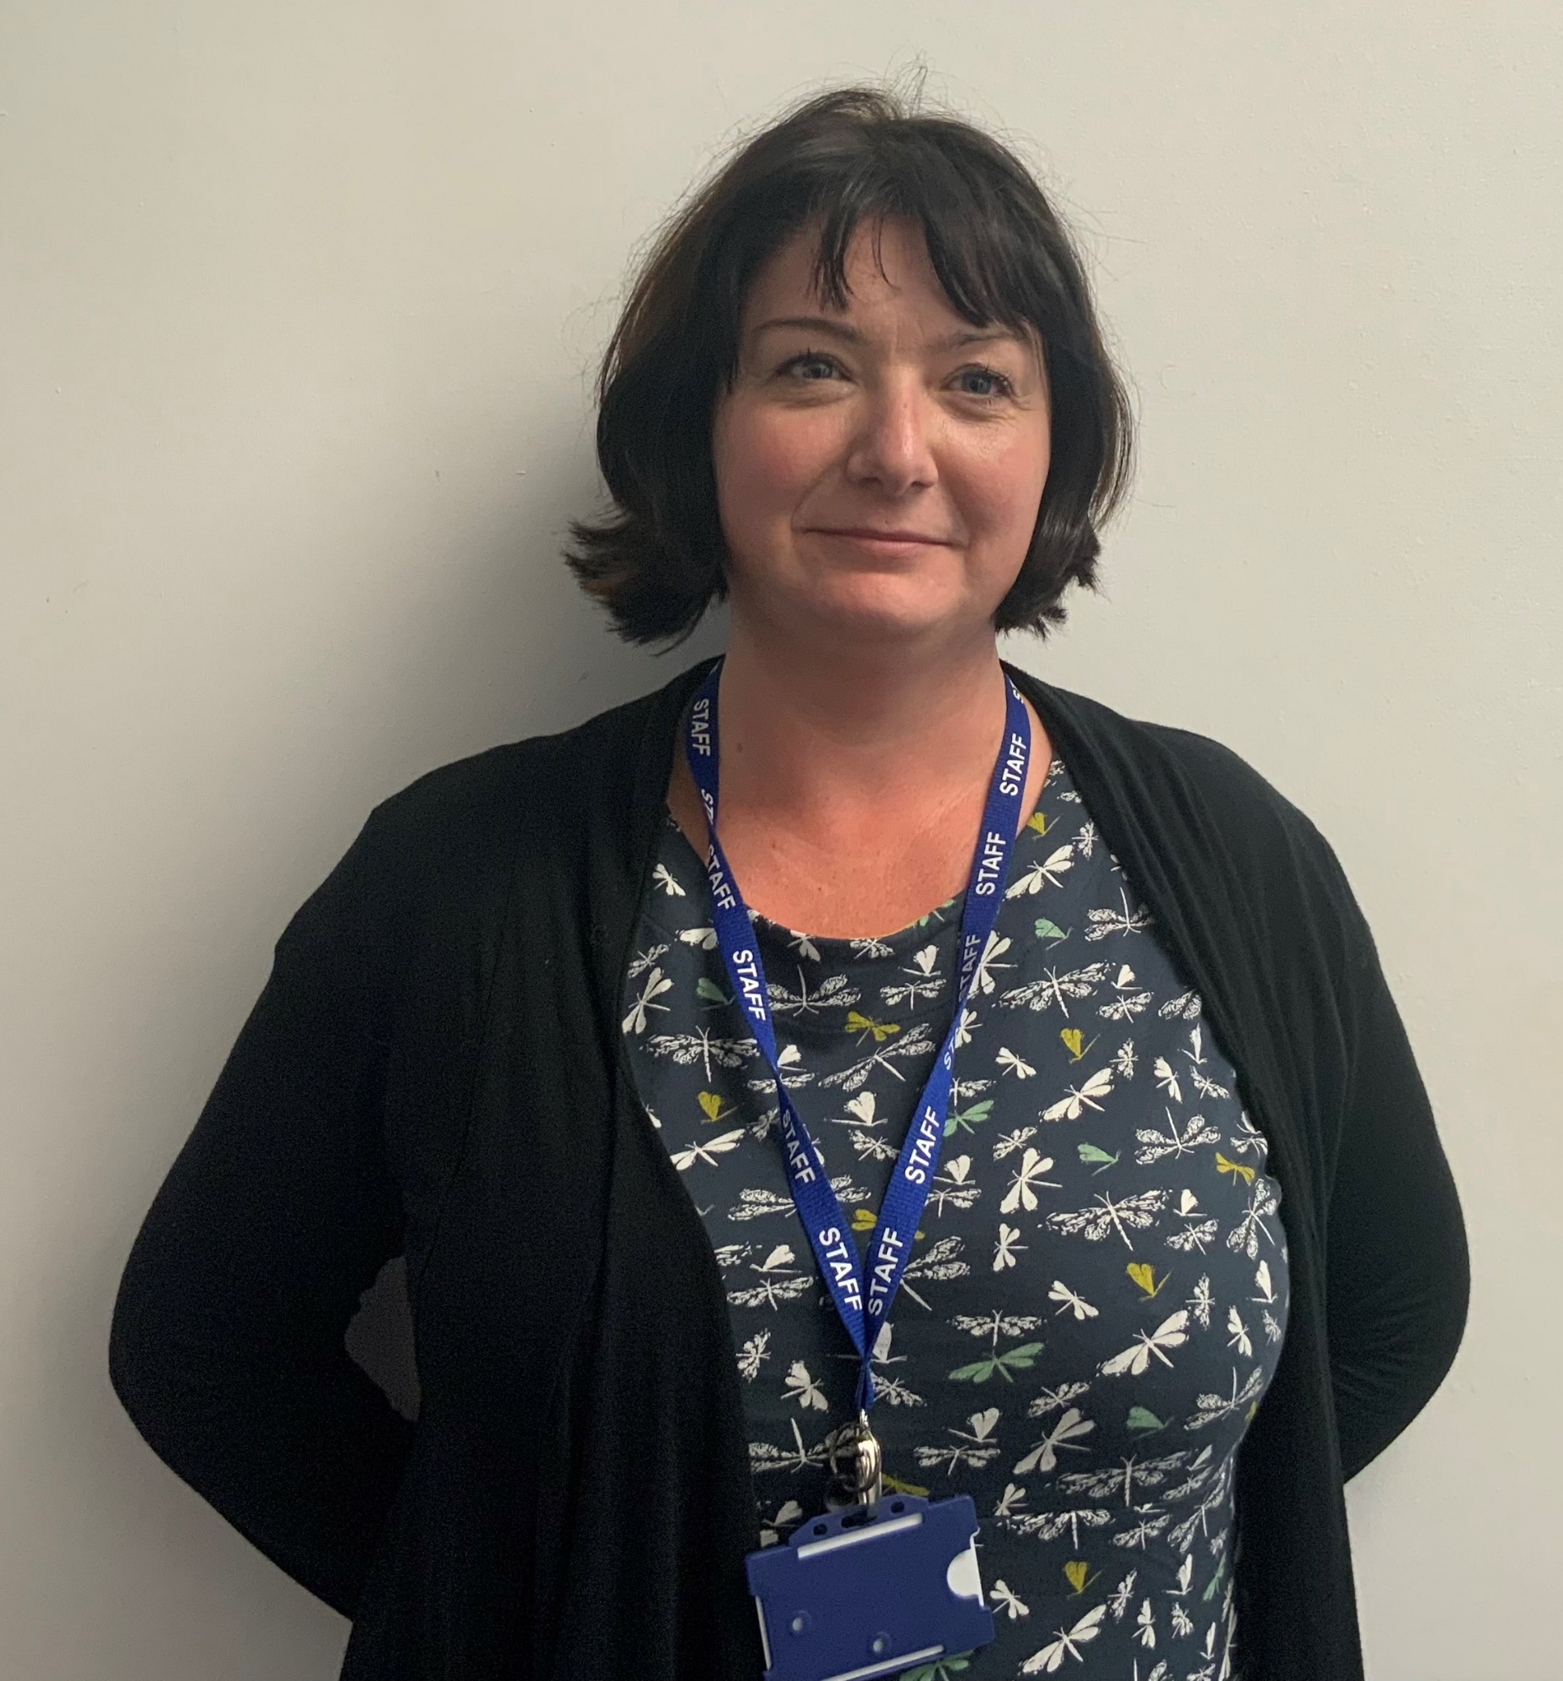
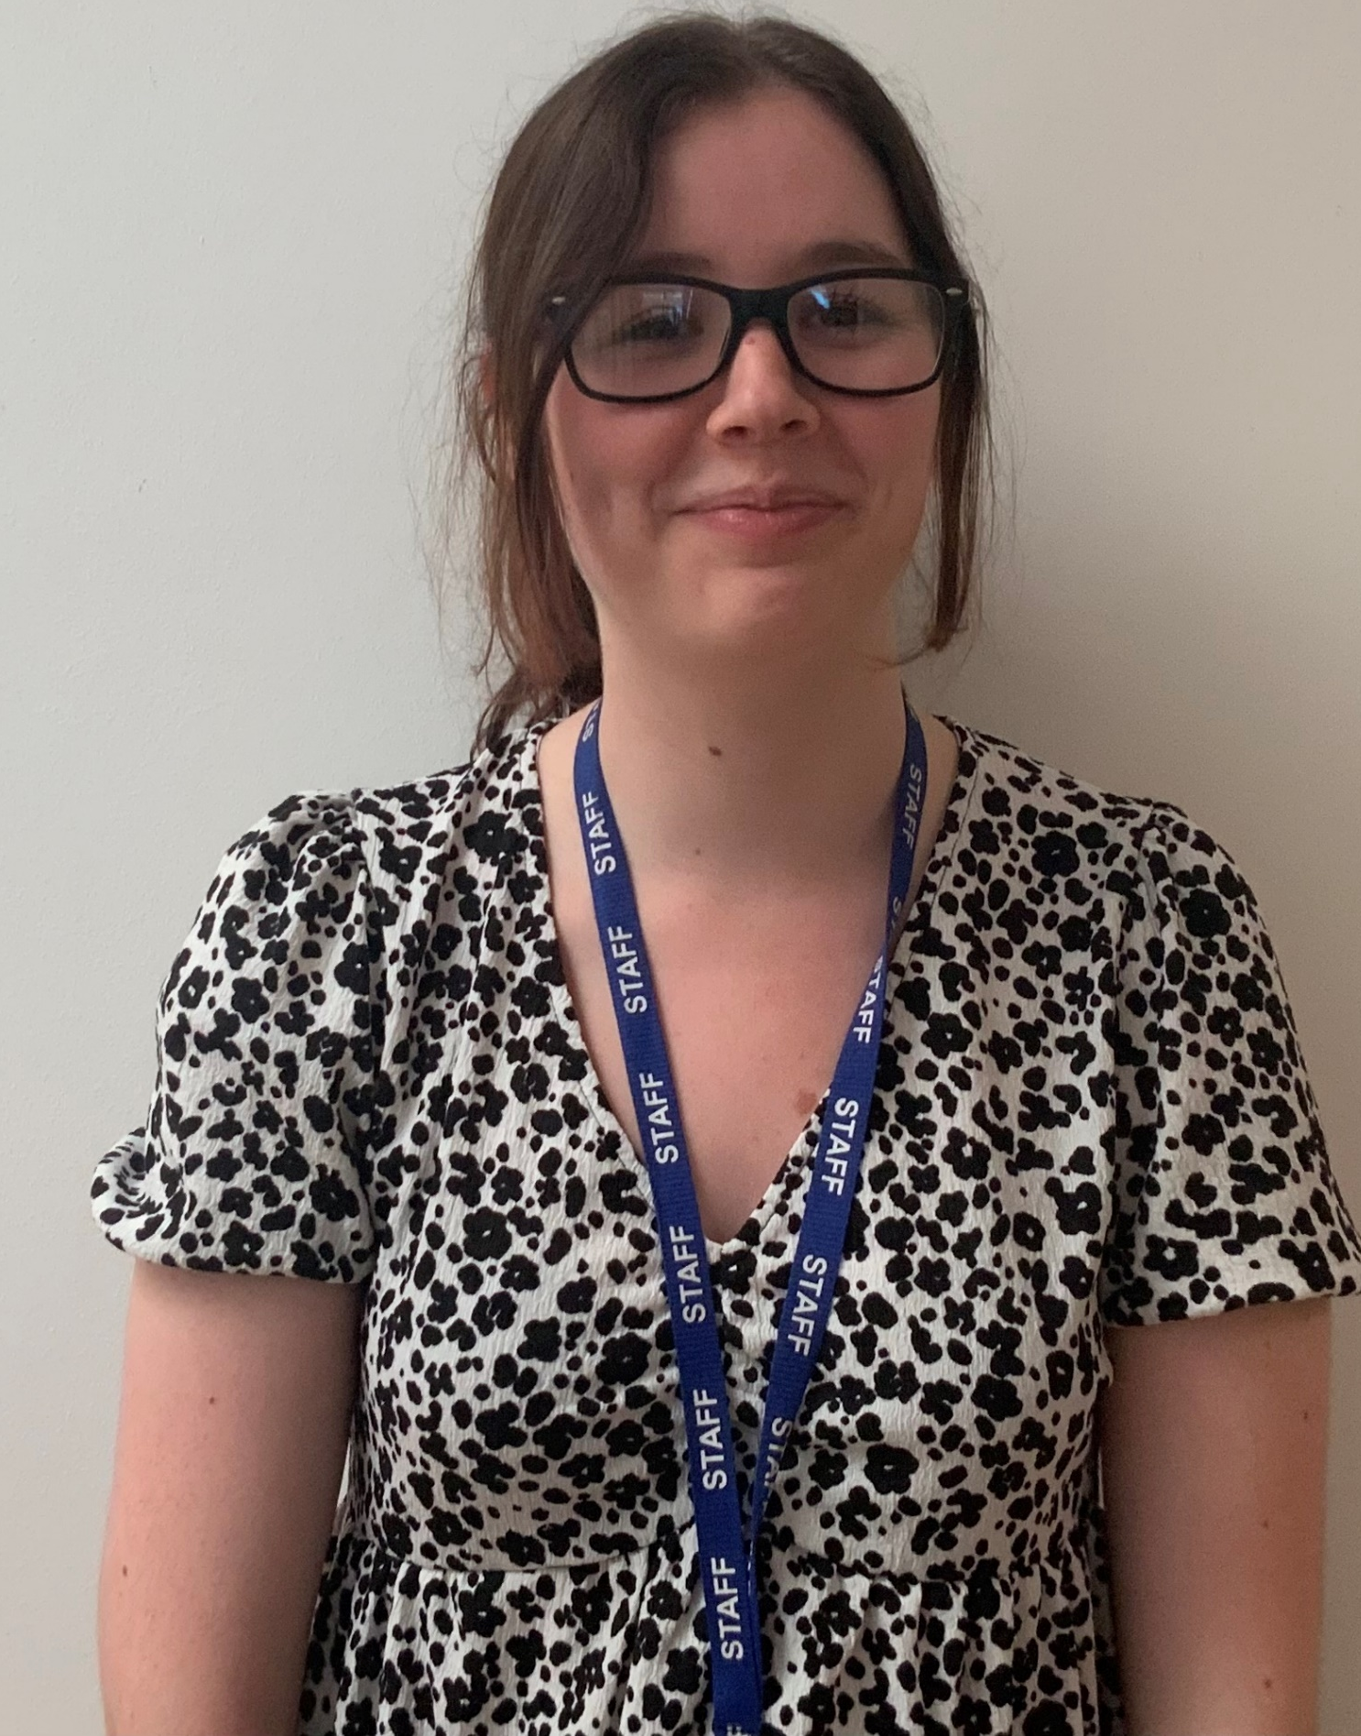
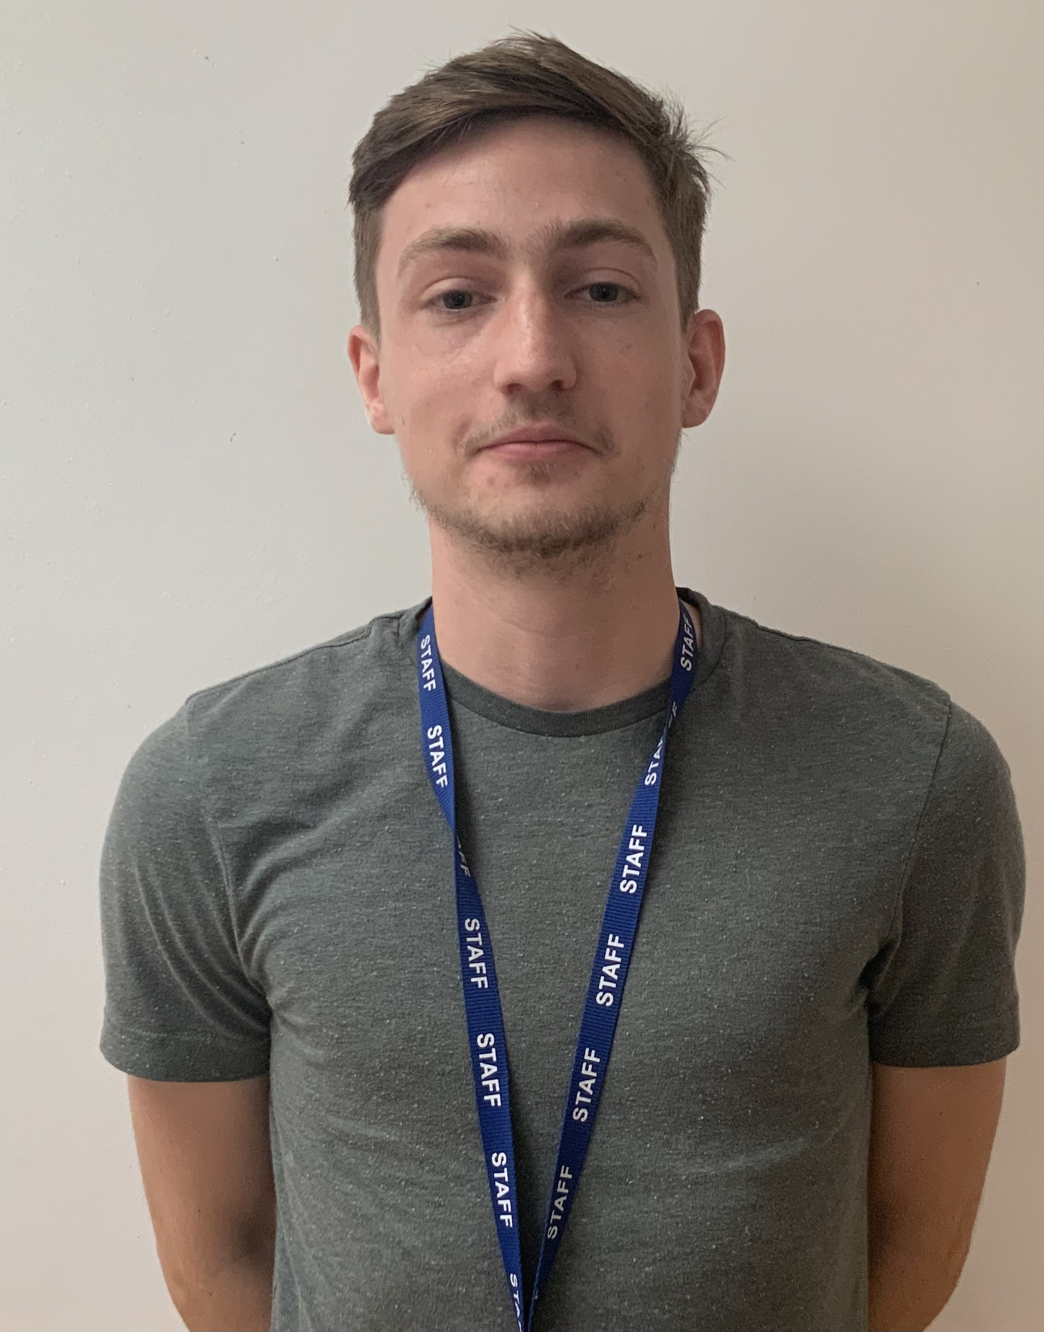
Meet the team!
Miss Cotterell (class teacher) Mrs Neal (class teacher) Mrs Darby (Class teacher on a Thursday)
Miss Broughton Mrs Vaux Miss McHattie Mr Nolan Our wonderful Support Staff

Slide 3
School Vision Statement
“…. Inspiring, nurturing and educating our children to serve God by reaching their full potential, serving our local community and by looking after our environment as global citizens of today and tomorrow….”
Faith, Hope and Love (1 Corinthians 13:13)
School Mission Statement
“Love your neighbour as yourself” (Luke 10:27)
School Values to support Learning and Behaviour
Be Safe, Be ready, Be respectful
Truthfulness, Creativity, Compassion, Friendship, Teamwork, Respect, Perseverance, Responsibility.

Slide 4
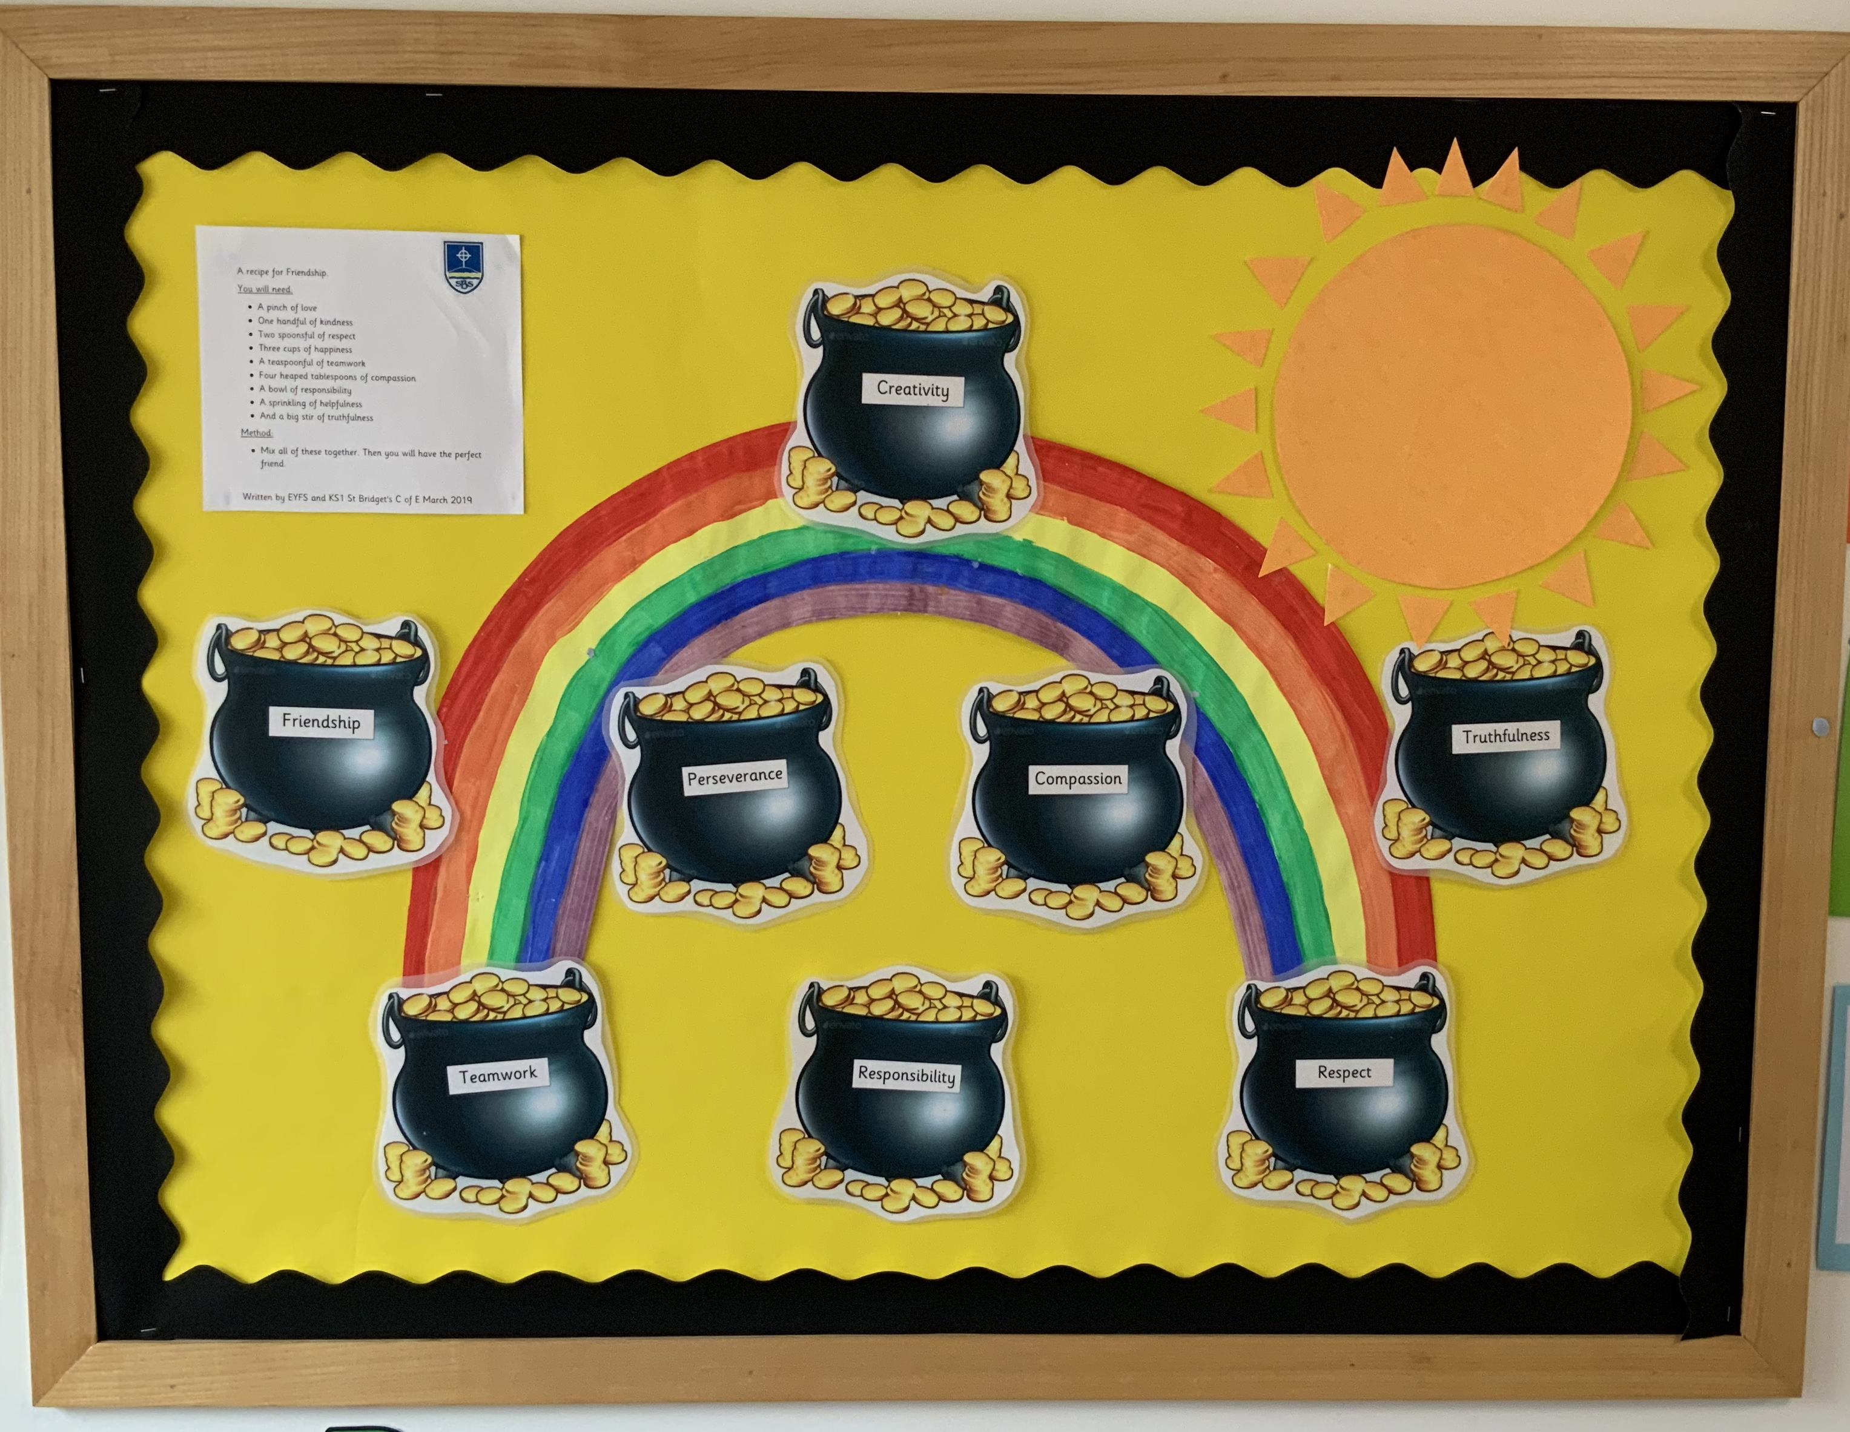
Promoting our values in the classroom- look out for us celebrating when your child has been put in a pot of gold, we will add an observation on tapestry to let you know which school value your child has shown us in class.

Slide 5
Bring a full named water bottle to school each day.
Homework / weekly overviews will be uploaded on the memo section of tapestry each week.
As the weather gets colder please make sure your child comes to school with named coats, hats and gloves as we use the outdoor area in all weather.
Please make sure all items of clothing are named.
PE day will be every Wednesday.
Please come dressed in PE kit for the whole day.

Slide 6
Morning fruit snack
We always have at least one variety of fruit available for the children each day. We are aware that some children are fussy and may not like what is available so we are allowing children to bring their own fruit in if they wish. This is optional and must only be one piece. It must also be something that they can get out of their bags each day independently. The children will eat it on the carpet so please be mindful of peeling etc we suggest an apple, banana, pear, small pot of grapes but they must be cut etc

Slide 7
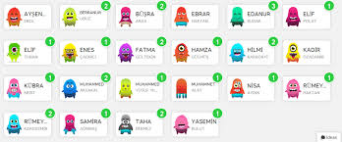
Reward system
Dojo points – children receive dojo points for positive behaviour throughout the week. Negative dojos can also be given for making poor choices.
Stickers – we like to give stickers to praise and inform parents of positive achievements
Verbal praise – this is vital and in the moment verbal praise happens constantly throughout the day
Merit assembly – Every Friday, we will reward one child from each class with the golden merit badge for the week. All children will get a chance, please understand we can only choose one child each week, so some may therefore not get it until the summer term but this is not an negative. All children wow us day in day out and it is always a hard choice. When it is your child’s turn to receive the badge you will be invited to attend our whole school merit assembly.

Slide 8
Topics for this term – Super me and Super you, Amazing Animals and Our Celebrations.
An overview of each theme will be sent out covering all areas of learning and weekly updates will be given via tapestry to keep you updated about what the children have been learning in class.

Slide 9
Baseline assessments have almost been completed and we are now planning weekly for next steps for every child.
Children's work – We have our online learning journal on tapestry – Here we will use the memo section to keep you informed and updated on what is going on in school. There will be the occasional wow moment which will be added to your child’s individual profile. You can also add your own to share with us.
Maths and Literacy books- We have a separate maths journals, literacy and phonics books for each child which include children’s work, photographs and written observations.
Structure of the day- Carpet sessions, continuous provision (discover and do) and adult led activities.
We are planning to hold some discover and do sessions after half term. These sessions will be a nice opportunity for you to visit the classroom, observe one of our carpet sessions and take part in some of our discover and do activities with your child. More details of this will follow very soon.

Slide 10
Maths and phonics teaching
Booklets

Slide 11
For your information
Absences – please email or phone school office: schooloffice@stbridgets.wirral.sch.uk
Daily notes and messages – Please email new starter email which goes direct to F2 teachers: newpupils2023@stbridgets.wirral.sch.uk
Drop off and pick up – 8.45 -9.00 drop off side entrance and 3.25pm pick up from the side entrance.
School teams- We will be putting the children in a school team, children with siblings will be put in the same team and other children are given either Marine, Shore, Ashton, Beacon or Hilbre.
Don’t be afraid to approach us, we are a partnership and want to make your child's first year at school special, memorable and enjoyable.

Slide 12

Your children have had a fabulous start to life at St Bridget’s and we look forward to our year ahead with them.

