Slide 1
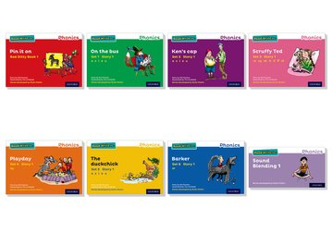
RWI storybooks
The Read Write Inc. Phonics storybooks provide structured practice in decoding words and reading through phonics. Each set of books is carefully graded so that children can read them with confidence, as soon as they have learned the sounds linked to the set.

Slide 2
Why?
it’s so important that children learn to read fluently as quickly as possible.
children read from books with the sounds they know, while they are learning to read. The sequence of reading books shows a cumulative progression in phonics knowledge.
give pupils sufficient practice in reading and re-reading books that match the grapheme-phoneme correspondences they know, both at school and at home.
we believe that the key to pupils’ success is their ability to read.
the ongoing assessment of pupils’ phonics progress is sufficiently frequent and detailed to identify any pupil who is falling behind the programme’s pace.

Slide 3
Storybooks
Lively phonics books are closely matched to children’s increasing knowledge of phonics and ‘tricky’ words (red words) so that, early on, they experience plenty of success. Repeated readings of the texts support their increasingly fluent decoding.
A thought provoking introduction, prompts for thinking out loud and discussion help teachers ensure that children comprehend what they are reading.
Teachers read aloud and discuss picture books with similar themes to those in the storybooks, so children build up background knowledge of the storybook.

Slide 4
Phonics books- reading
Children read the story at least 3 times during the week. On the first read, children focus on accurate word reading; the second, on developing fluency; and the third, on comprehension. Fluency and comprehension increase with each repeated reading.

Slide 5
Accuracy:
Children learn to:
-review previously taught sounds,
-sound out the names of characters and unfamiliar words,
-understand the meanings of new words,

Slide 6
Fluency:
Children learn to:
-read the words in the story speedily,
-track the story, ‘jumping in’ when the teacher hesitates,

Slide 7
Comprehension:
Children learn to:
-predict the outcome,
-discuss and compare key moments in the story,
-answer questions about the story,
-read the same story at home.

Slide 8
Home reading
At the end of the week we will send the books home.
Please listen to your child read the storybook and celebrate their success’ with them.
There is no reading record.
Books must be returned to school on Monday.

